Slide 1
MURDOCH GRADUATION 2025
You're almost done!
You're almost there!
Don't quit now – get everything done!
Before you cross the stage and receive your High School Diploma, you MUST.....
Finish your coursework.
Hand in your assignments and assessments on time.
Pass your classes!

Slide 2
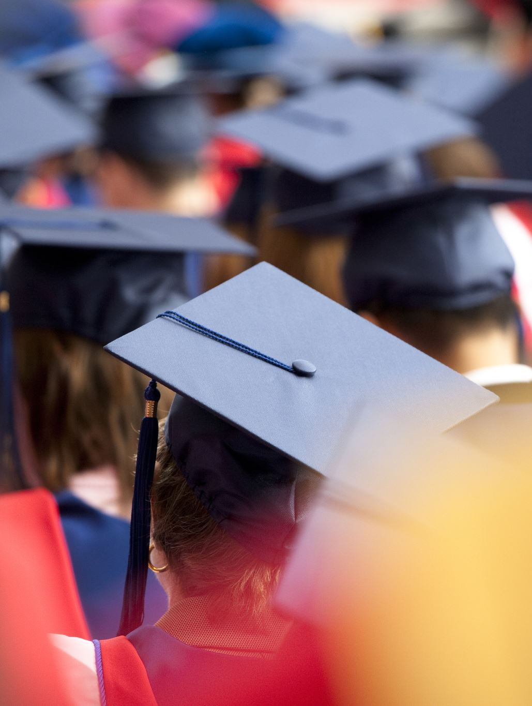
DATES to remember.....
Grad Breakfast:
Friday, June 20th
(@ Murdoch MacKay Collegiate)
Convocation:
Tuesday, June 24th
(@ Murdoch MacKay Collegiate)
Dinner & Dance:
Wednesday, June 25th
(@ Club Regent Event Center)

Slide 3
Grad Breakfast
Friday, June 20th
9:30 am
@ Murdoch MacKay Collegiate

Slide 4
GRAD BREAKFAST DETAILS
Arrive between 9:30 am and 10 am at the North Doors!
Put your handprint and signature on the Grad Handprint Mural.
Go to the big gym.
Breakfast will begin at 10 am!
Enjoy a breakfast of pancakes, sausages, fresh fruit, and juice/water.
Before you leave, pick up your Cap & Gown at the North Doors.

Slide 5
CONVOCATION
Tuesday, June 24th
@ Murdoch MacKay Collegiate

Slide 6
**IMPORTANT** DURING THe days before convocation....
Take pictures in your Cap & Gown with family and friends.
You will not have time after your Convocation Appointment to take pictures since you have to return your Cap & Gown right after your appointment time.

Slide 7
CONVOCATION DETAILS
Graduates will sign-up online for a convocation appointment time slot. There will be 4 time-slots throughout the day and each graduate must choose one. The times are: 9:00am, 10:30am, 1:00pm and 2:30pm. Sign-Up for Ceremony times will be from May 12 to May 16. This will be done online via Conference Manager. The link for this will be sent out closer to these dates. Graduates will be attending their Convocation Ceremony in groups of 50. We are anticipating ceremonies to last between 45 minutes to 1 hour in duration.

Slide 8
CONVOCATION DETAILS
Graduates and guests must arrive at their Convocation Ceremony time 15 minutes prior to their ceremony time. Graduates will meet in the Cafeteria and line up for the ceremony, guests will find a seat in the large gymnasium. Immediately following the ceremony, graduates and their guests will move to the Susan Auch Gym where there will be some photos ops. This is also where graduates will return their gowns.

Slide 9
CONVOCATION DETAILS
Graduates must check-in their gown following Convocation. When Graduates check their gown in, they will receive an envelope with important documents enclosed (report card, transcript, memento, etc.). Anyone who does not check-in their gown will be charged for the price of their gown. The gown is electronically linked to your name. Graduates will keep the cap and tassel.

Slide 10
Cap & Gown
NOTE: If you have NOT paid your student fees this year, you will not be able to pick up your grad cap & gown until you pay them!
Wear clothing underneath your gown as the gown will be returned before you leave.
The white piece is called a v-stole.
You wear the v-stole with the pointed part in the back.
The graduation cap is worn with the pointed part in the front (basically on your forehead).
Your cap will be worn with the tassel on the right-hand side.
After you graduate, you can move your tassel to the other side.

Slide 11
**IMPORTANT**
When you graduate, leave your mark as you cross the stage to receive your diploma.
In the form you will complete before leaving today, we will be asking you to tell us what you’d like us to say about you as you’re graduating. It could be a paragraph about what you’ll be doing next year, a famous quote that means something to you, words you live by, you might want to thank specific family members and/or friends, etc.
We asked you to think about this at the last TA meeting. Today, you will complete the form with this information.

Slide 12
Here are some examples….
Ms Blazek would like to say, “Part of the journey is the end. Thank-you to my teachers who have supported me, as well as my friends who have made school more fun. Lastly, to my parents who have given me everything I could ever need, I am grateful.”

Slide 13
Mr. A will be attending The University of Manitoba in the fall where he will be playing football for the Bisons and will be enrolled in University One. He would like to thank all of his teachers, coaches, and family members who have helped him throughout his years of school.

Slide 14
Bob would like to say, “Thank-you to all the people who made my life so memorable, whether we laughed together, or I was motivated and pushed by you, I treasure our endeavors, friends, and family.”

Slide 15
Ms. Fil says, “Through high school there have been ups and downs but I’m glad I had my closest friends and family to help me through it. I want to say thank-you to them as I move on to explore the world and what it has to offer.”

Slide 16
Ms. Blazek wants to share this quote said by Nani from Lilo and Stitch, “Sometimes you try your hardest, but things don’t turn out the way you want them to. Sometimes, things have to change. And maybe sometimes, they're for the better."

Slide 17
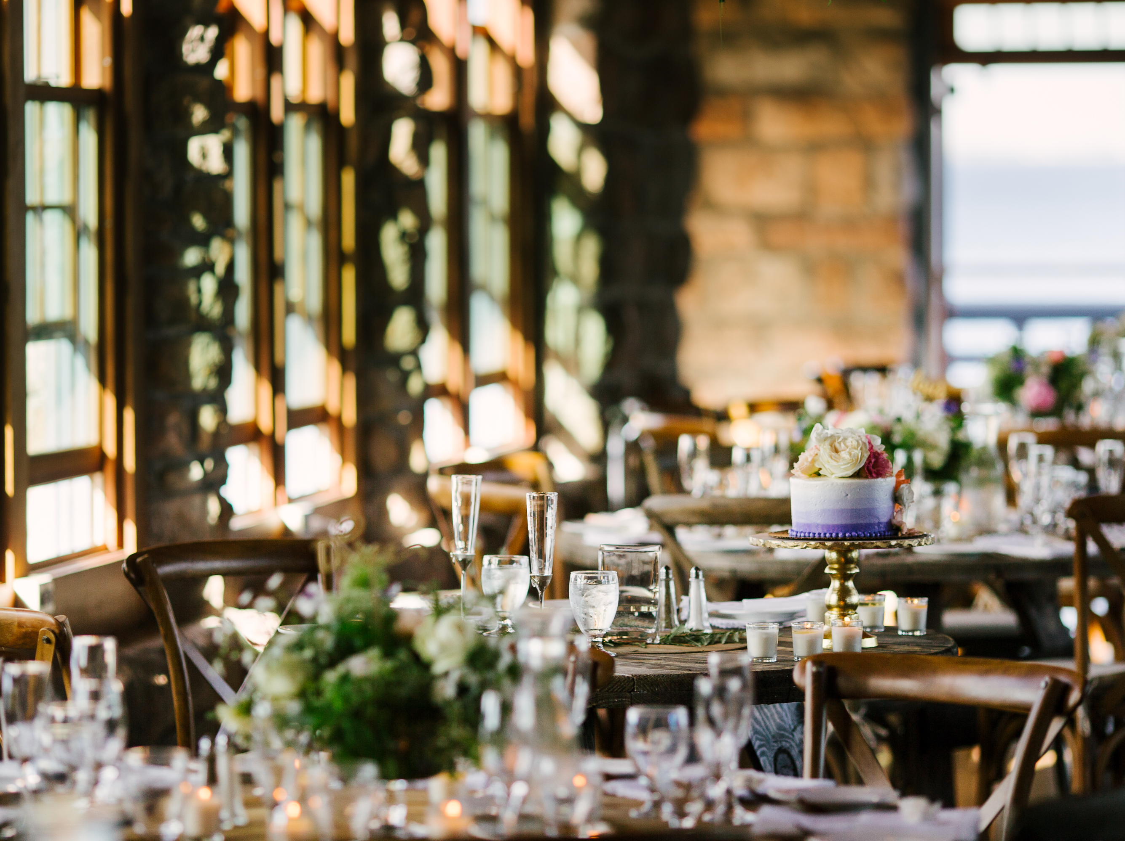
SAFE GRAD 2025
mmsafegrad@gmail.com
Wednesday, June 25th
@ Club Regent Event Center
**You will have tickets if you are attending this event.**
If you have any questions about Safe Grad e-mail: mmsafegrad@gmail.com

Slide 18
GRAD WEAR
Reminder:
You can still purchase Grad Wear online through Entripy Shops.
The link is on the Murdoch Homepage.

Slide 19
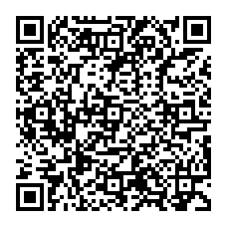
SAFE GRAD SLIDESHOW
Share your “school life” pictures with Mrs. Grehan…..
This slideshow will run throughout the Safe Grad Event in June.

Slide 20
Complete this form
must be done by MAY 9TH!!!!

Slide 21
??Questions??
??QUESTIONS??

