Slide 1
Community Budget
Information Meeting
January 29, 2026

Slide 2
Land Acknowledgement
RETSD is located on the original lands of the Anishinaabeg, Ininiwak, Anishininiwak, Dakota, and Dene peoples, and on the homeland of the Red River Métis.
We recognize our part of the Treaty relationship and, as acknowledgement of the harms done, we commit to collaborating with Indigenous communities in the shared spirit of Truth and Reconciliation for the healing and inclusion of all who share this Land.

Slide 3
Agenda
Land Acknowledgement
Welcome & Opening Remarks
Budget Process & Highlights
Questions & Comments
Concluding Remarks

Slide 4
Using the Q&A Function
Please use the Q&A function on the live stream to post your questions. This can be done at any time during the meeting.
We’ll respond to questions that focus on the budget.
Please identify your name. Anonymous questions will not receive a response.
Questions will be read aloud.
Duplicate questions will be answered once.
As we’ve done over the last few years, the slide deck from this evening will be posted on our website, along with Q&A listing the questions that were asked, and any pertinent ones that may not have been addressed.

Slide 5

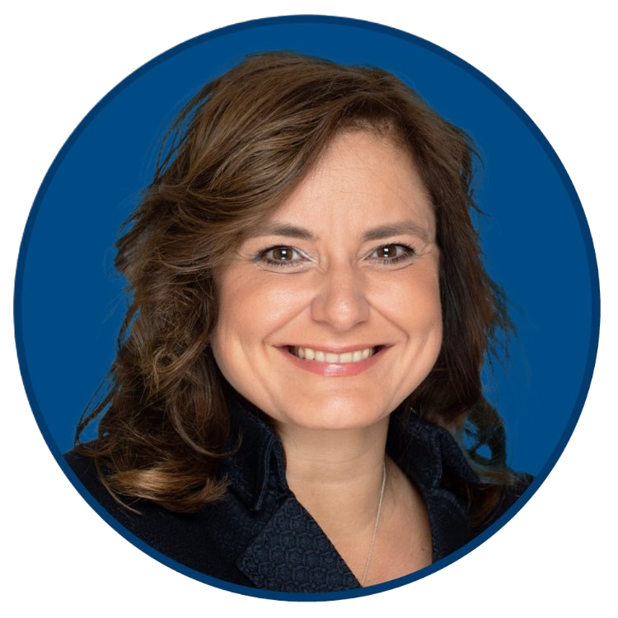
Opening Remarks
Board of Trustees
Brianne Goertzen,
Chair—Finance, Facilities,
Transportation & Technology
Ward 3 Trustee
Administration
Sandra Herbst
Superintendent/CEO

Slide 6
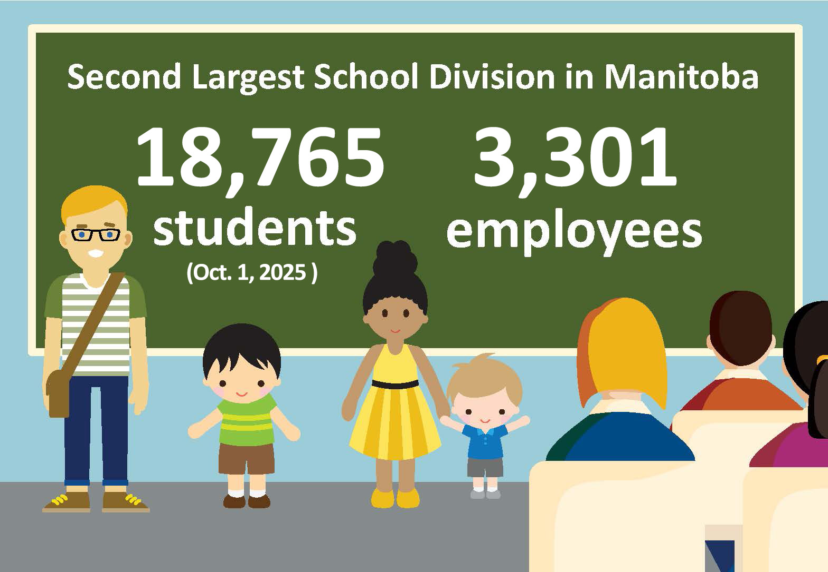
By the Numbers
Notes:
Update employees to 3,697
Update students to 18,761

Slide 7
Budget Context
Long-standing inequities in the provincial funding formula
Limited commercial tax base, pressure on homeowners
Rapid enrolment growth has pushed schools to capacity, critical need for new schools
Aging infrastructure and deferred maintenance
Rising technology, cybersecurity, and insurance costs
2% cap on taxes for six years, still in recovery
Equitable provincial funding is critical to sustain public education

Slide 8
Educational Context
Costs continue to rise:
Staff salaries and benefits
Utilities, fuel, and maintenance
Learning resources and materials
Costs related to rapid curriculum change and educational legislation
An increasing number of students with additional learning needs, requiring corresponding growth in specialized supports and resources.
Divested services from health, justice, and family services to the school division

Slide 9
Enrolment
Highlighted numbers are projected from Baragar
Notes:
Enrolment starting increasing in from 2020-21
Enrolment is still on the rise in RETSD
In 2023-24 RETSD had over ??? newcomer students
For 2024-25 we projected 18,769 students and had 18,761, Baragar projections seem to be back on track

Slide 10

Budget Process & Highlights
Administration
Elise Downey
Secretary-Treasurer/CFO

Slide 11
Timeline
Prepare budget estimates for Trustees
Funding announcement from Province of Manitoba
Budget deliberation meetings
Second virtual community budget information meeting (to be determined)
Final budget set for 2026–27 before the end of March 2026
Tax notices issued by March 15, 2026
Notes:
As a senior administration team, we prepared the DRAFT budget for the Trustees’

Slide 12
Guiding Factors
Operating costs reflect market adjustments for existing services, supplies, materials, utilities, insurance, etc. These costs have become unpredictable since the pandemic.
The Consumer Price Index (CPI) for Manitoba for 2025 is higher than the previous year. The annual CPI was 2.7%, compared to 1.1% for 2024.
Notes:
Even though the CPI seems to have stabilized, we all know the cost of everything has went up.
I think it’s safe to say most people are aware of the increasing costs of groceries, utilities and fuel.
As I mentioned last year, the average price of a bus was $180,000; that has now increased to $200,000.

Slide 13
Divisional Expenditures
Notes:
2025-26 2024-25
Salaries & benefits 231.45 217.19 86.6%
Operations 6.88 6.20 2.6%
Programming 6.97 6.68 2.6%
SS 1.21 1.12 0.5%
Tech 7.16 6.69 2.7%
Trans 1.58 1.59 0.6%
Mtc 12.06 11.7 4.5%
$267.4 $251.17
The % spent on salaries and benefits, operations (Supt and ST depts), and maintenance have decreased slightly over the last 10 years.
Programming has stayed the same
SS, technology and transportation have increased slightly

Slide 14
Inequitable Impact of Funding on Average Home (2023)
School Division | Special Requirement | Tax increase to average home | Tax decrease to average home
SJASD | 2% |  | $94.00
PTSD | 2% |  | $5.00
LRSD | 2% | $2.00
RETSD | 2% | $13.00

Slide 15
Using the Q&A Function
Please use the Q&A function on the live stream to post your questions. This can be done at any time during the meeting.
We’ll respond to questions that focus on the budget.
Please identify your name. Anonymous questions will not receive a response.
Questions will be read aloud.
Duplicate questions will be answered once.
As we’ve done over the last few years, the slide deck from this evening will be posted on our website, along with Q&A listing the questions that were asked, and any pertinent ones that may not have been addressed.

Slide 16
Concluding Remarks &
Next Steps
Notes:
Thank you for taking the time out of your busy schedules to join us this evening, it is much appreciated. We want to continue our conversations with you. We are committed to communicating effectively and positively with our stakeholders – all of you – to provide clarity and transparency.

Slide 17
Contact Information
Send us your comments!
By email through the “Contact Us” page of the RETSD website at: retsd.mb.ca
By mail at: 589 Roch St.
Winnipeg, MB
R2K 2P7

Slide 18
Contact Information for Premier, Education Minister and Local MLAs
To advocate for additional funding and an equitable funding model

