Slide 1
Community Budget Information Meeting – Part 2
March 5, 2026

Slide 2
Agenda
Land Acknowledgement
Welcome & Opening Remarks
Budget Update
Recap
Questions & Comments

Slide 3
Question & Answer
Use the question (Q&A) feature on the live stream.​
Please identify yourself (we will not answer anonymous questions).​
Questions will be read aloud.​
Duplicate questions will be answered once.​
All pertinent questions not addressed during the meeting will be answered and posted as a Q&A on the RETSD website.​

Slide 4
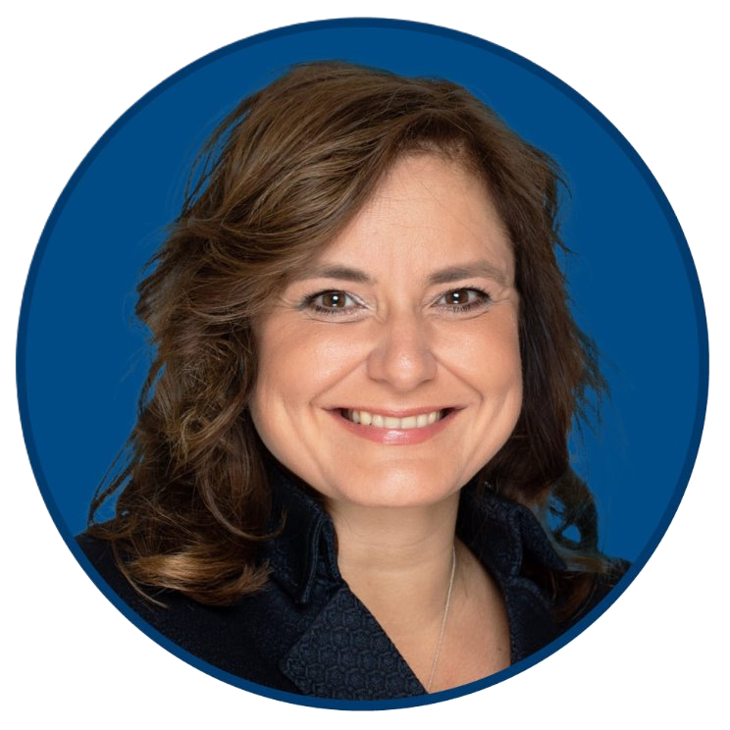

Opening Remarks
Board of Trustees
Brianne Goertzen,
Chair—Finance, Facilities, Transportation & Technology
Ward 3 Trustee
Administration
Sandra Herbst
Superintendent/CEO

Slide 5
The Reality
The Board of Trustees has spoken over the last number of years to MLAs, ministers of education, and our community about the continual and cumulative effects of underfunding and reductions to RETSD.
RETSD has made several presentations about a new and equitable funding model, but more importantly funding that supports public education.
Due to the lack of funding and an inequitable funding model, we are expected to do more with less as student needs continue to grow and we face the continued impact of a rapid population increase.

Slide 6
Provincial Funding Announcement
On February 9th, the Province of Manitoba announced education funding for the 2026-27 school year.
RETSD received an additional $4.0M for 2026-27, which is the same as what we received last year and half of what was received the previous year.

Slide 7
Status Quo Budget
A status quo budget represents the funding that is required to maintain current levels of programs, programming, and services for students and staff based on estimated student enrolment for the 2026-2027 school year. It also includes increases to fixed costs (e.g., such as negotiated salary increases, insurance, utilities, statutory benefits).
The funding model does not take into consideration the increased costs to cover the status quo budget.
Government funding does not cover the status quo budget.
Notes:
Increased costs such as increased cost of a bus.
The 4.0M increase does not cover the contractual requirements of the provincially bargained teachers collective agreement even though the agreement goes until June 2026 and costs are known.

Slide 8
Status Quo Budget (cont.)
The status quo budget includes additional costs for the following:
Maintaining staffing, as enrolment is projected to be similar to the current enrolment
IT security enhancements
Inflationary increases for consumables and insurance
Notes:
Due to the timing of the new school, RETSD has had to plan to move 100’s of students last fall due to schools be at or over capacity.

Slide 9
Enhancing the Status Quo Budget
The Board of Trustees is considering adding the following increases to expand programs:
Additional clinical supports to address long student waitlists
Enhanced safety measures related to school access
Unfunded items for the new school (e.g., fibre optic connection, library books, physical education equipment, bleachers)

Slide 10
Budget Highlights
The 2026-27 budget is $276.7M.
The revenue available, including provincial funding, totals $140.4M.
The difference of $136.3M must be raised by increasing taxes to balance the budget.
City of Winnipeg portion mill rate increase of approximately 6.6%.
Increase to the average home in RETSD valued at $361,700 is $40.42, or $3.37 monthly.
Notes:
The status quo budget is an increase of $8.4M

Slide 11
New Tax Rebate
In 2025, the province announced a new education tax rebate called the Homeowners Affordability Tax Credit (HATC).
The tax credit is applied directly to the property tax statement.
The tax credit only applies to a taxpayer’s principal residence.
It has increased from $1,500 to $1,600 for 2026.

Slide 12
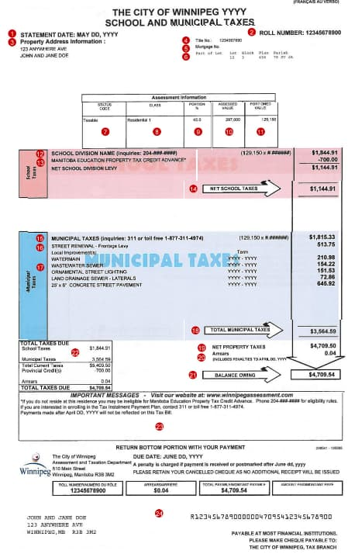

Slide 13
Recap
The funding formula did not change as we had hoped. It continues to be inequitable. We will continue to advocate for a new equitable funding formula that supports public education.
The Board of Trustees does not want to cut classroom staffing and resources, so the difficult decision is before us to increase taxes so that we can maintain services and programs within RETSD.

Slide 14
Budget Considerations
The RETSD community has identified, through a past ThoughtExchange, the community forum, and virtual meetings, that they do not want reductions to current programs, programming, and services, but rather a strengthening of what already exists.
After years of reductions, to reduce RETSD’s budget further would have devastating and permanent impacts, including increased class sizes and a reduction in classroom teachers and educational assistants.

Slide 15
Question & Answer
Use the question (Q&A) feature on the live stream.​
Please identify yourself (we will not answer anonymous questions).​
Questions will be read aloud.​
Duplicate questions will be answered once.​
All pertinent questions not addressed during the meeting will be answered and posted as a Q&A on the RETSD website.​

Slide 16
Process Update
This is the second information meeting with our community.
The board intends to approve the budget before Friday, March 13, 2026.
A budget press release will be issued the day after the budget is approved and the budget issue of The Torch will be available in early spring.
As always, Trustees are available to answer further questions.

Slide 17
Contact Information for Premier, Education Minister and Local MLAs
To advocate for additional funding and an equitable funding model:

Slide 18
Contact Information
Contact information for your local trustee is available under ‘Board of Trustees’ at retsd.mb.ca or by scanning the QR code:
Email the school division: info@retsd.mb.ca

