Slide 1


CMMC Planning Beyond Graduation
2025-2026

Slide 2
Important Dates:
June 23rd – Convocation – 4 set times
June 24th – Grad Dinner and Dance
December 1st – University Early Application – (Draw for $5000 U of M)
March 1st – Post Secondary Applications – Deadline for Entrance scholarships
March 1st – Deadline for Forms for Internal Scholarships & Awards
U of Manitoba
Fall Open House: Oct. 28th, 2025​ 5:30 - 8:30 P.M. In Person ​
Fall Virtual Open House: Nov. 12th, 2025 3:00 - 8:00 PM
U of Winnipeg
Future Student Night: November 25th, 2025, 5:30-8:30 P.M.

Slide 3


SUIT UP & GOWNS FOR GRAD- COMING SOON

Slide 4

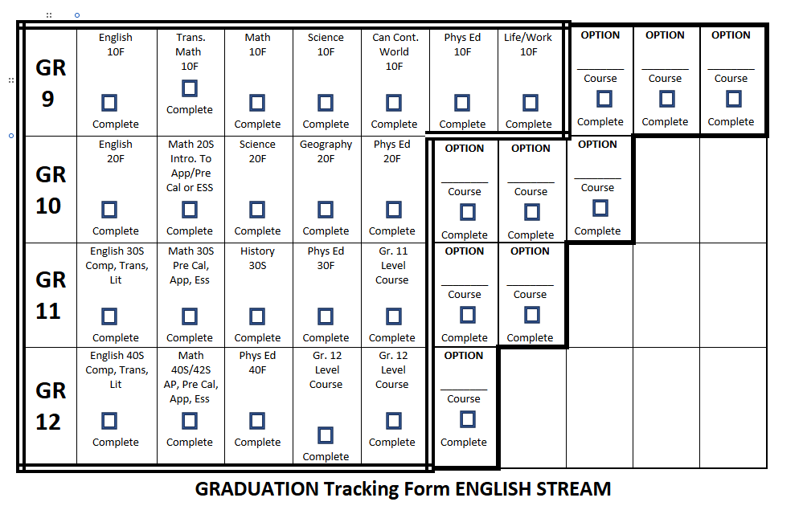
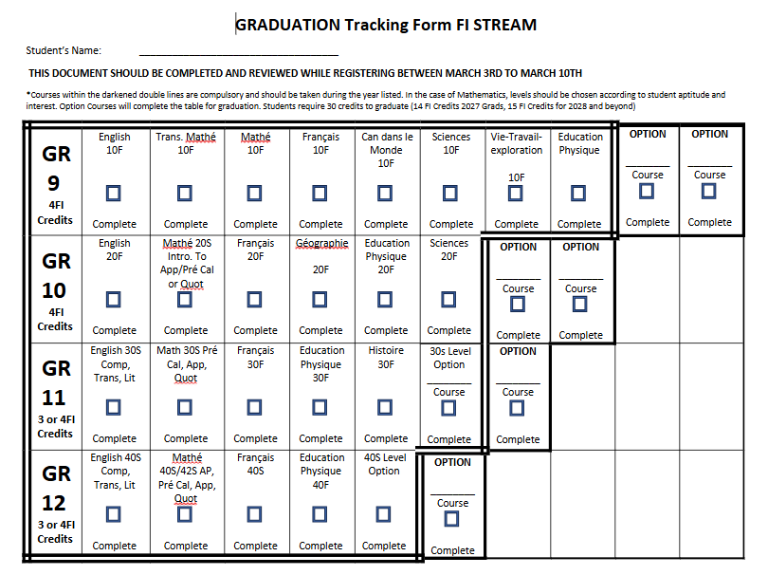
Grad Requirements
Triple Check!!!
FI- 14 Credits total with 3 at the grade 12 level

Slide 5
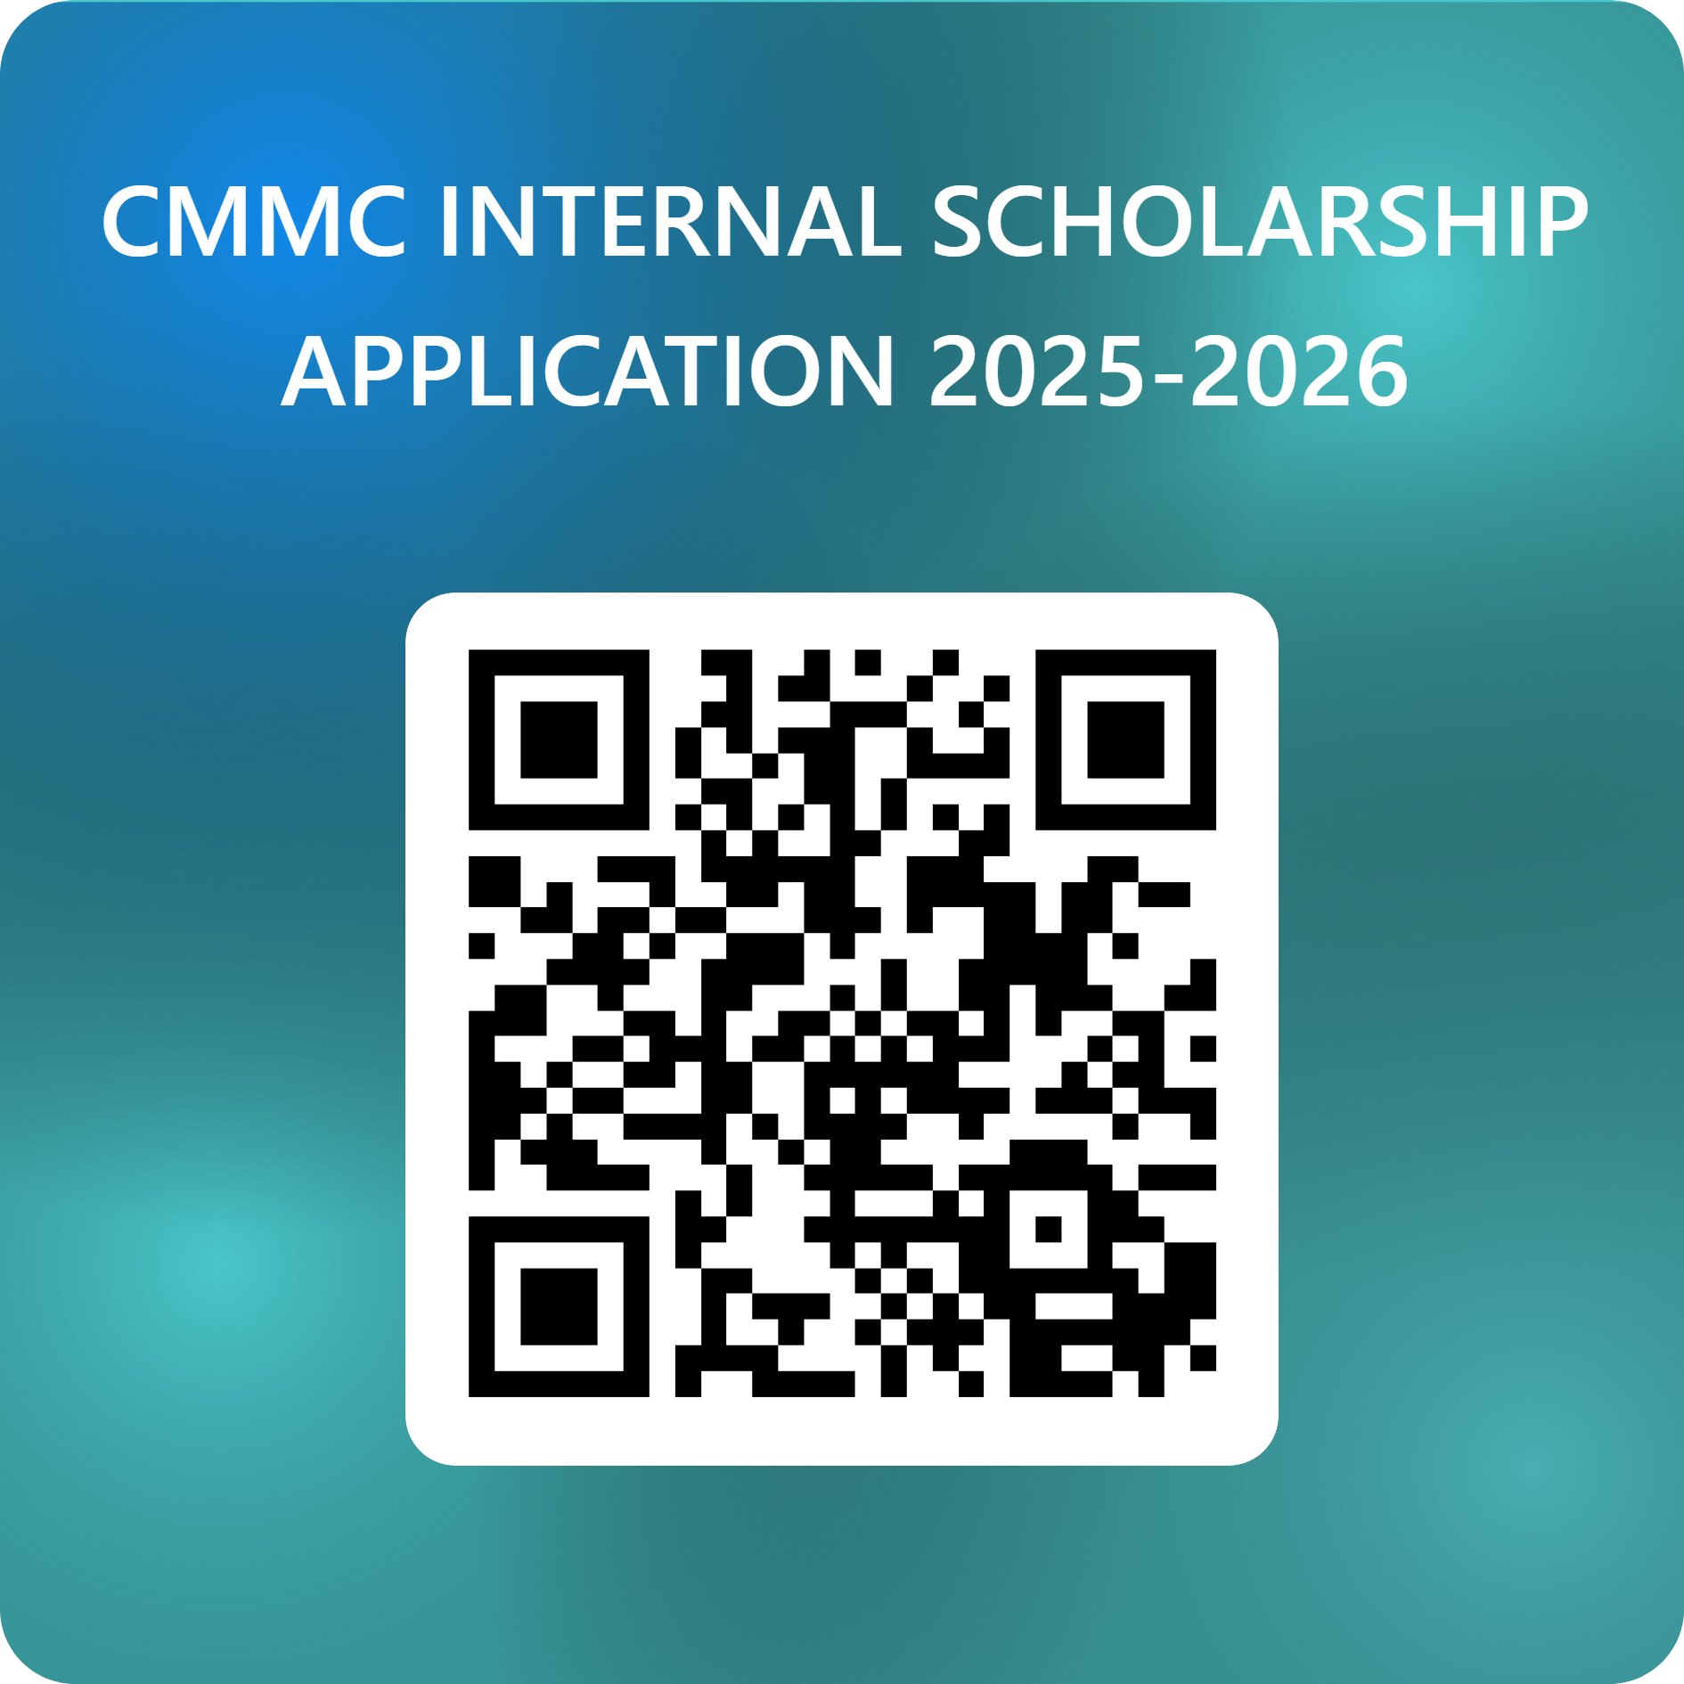
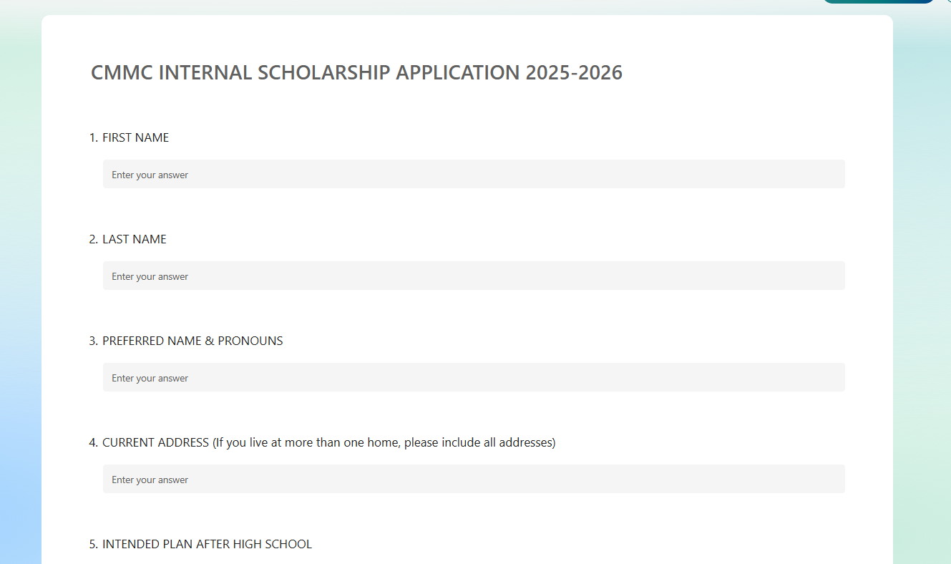
Internal Scholarships
MARCH 1st

Slide 6
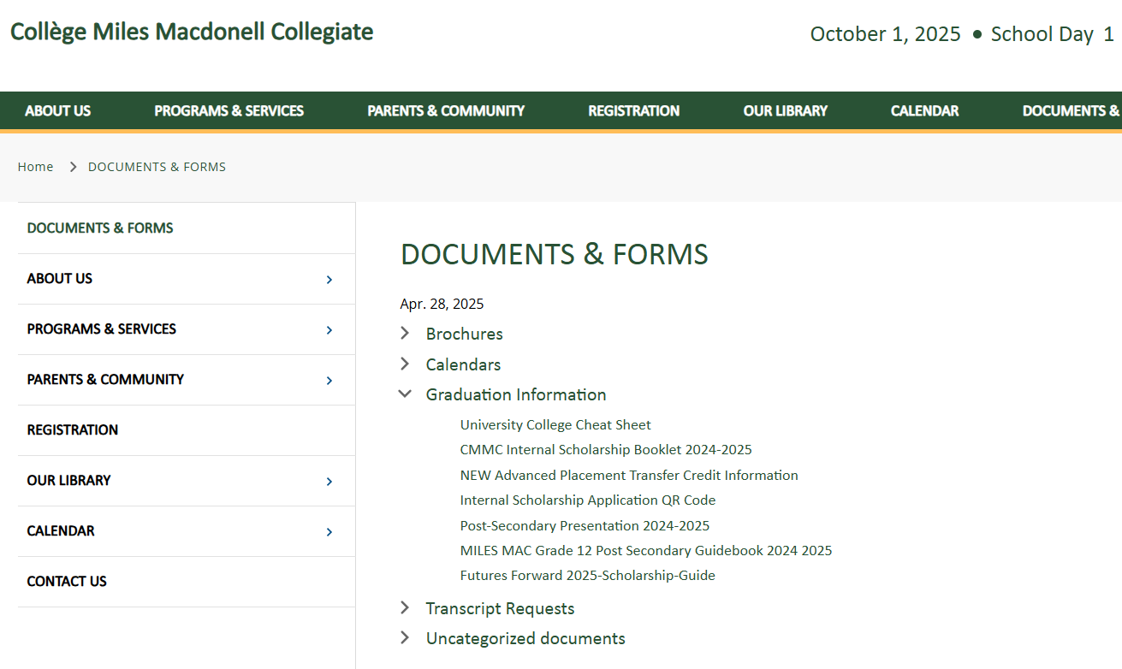
CREATE an email that is not your CMMC school account for all things post secondary

Slide 7
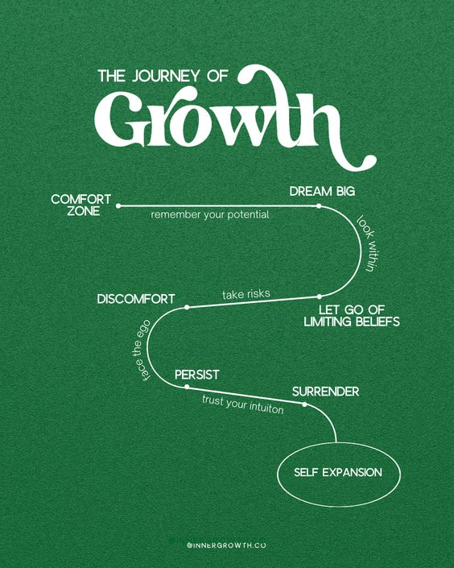
It is okay to be unsure as to what you want to do in the future.​
It is okay to change your mind as to what you want to do.​
Keep an open mind.​
Your path may change as you grow and change.​
Students tend to change their minds up to three times in university as to what they want to major in.

Slide 8

Your ONE-STOP SHOP Planning tool!
Located on the CMMC website: under DOCUMENTS & FORMS → Graduation Information

Slide 9
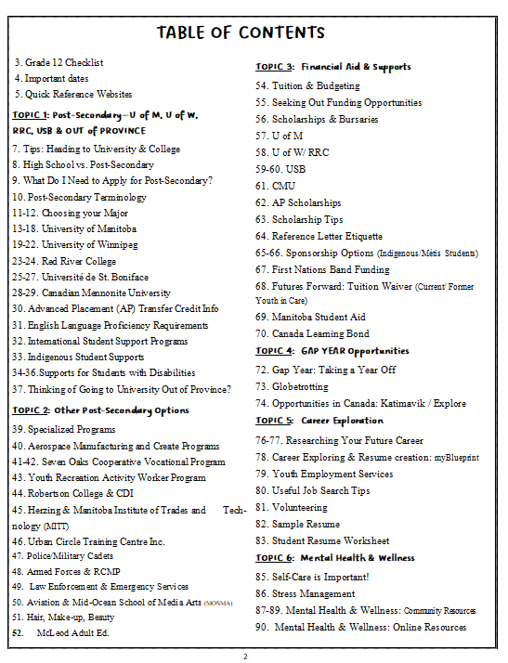







Slide 10
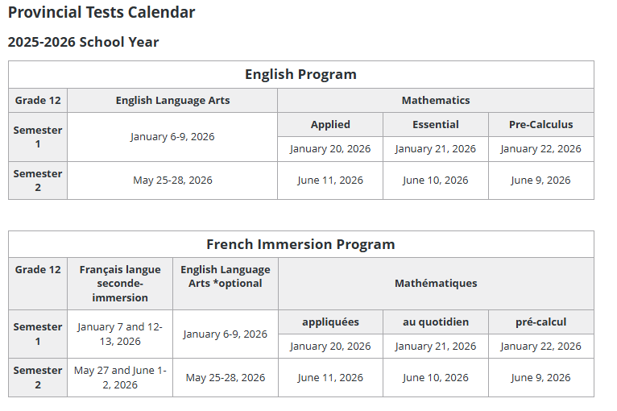

Slide 11
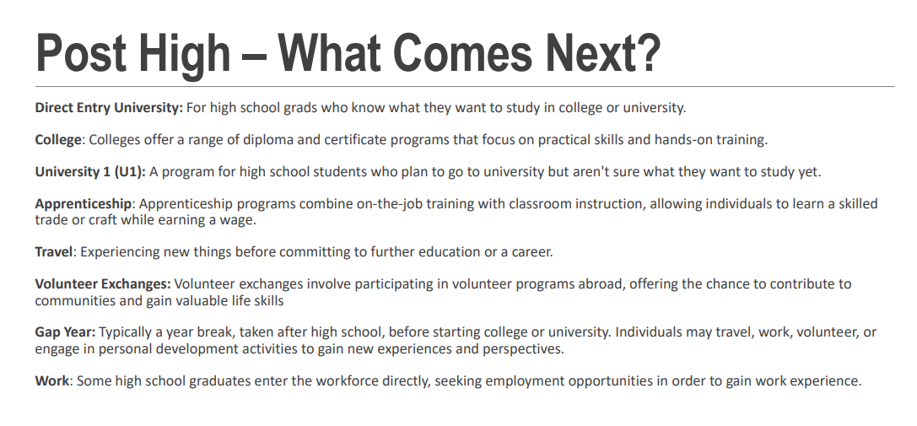

Slide 12
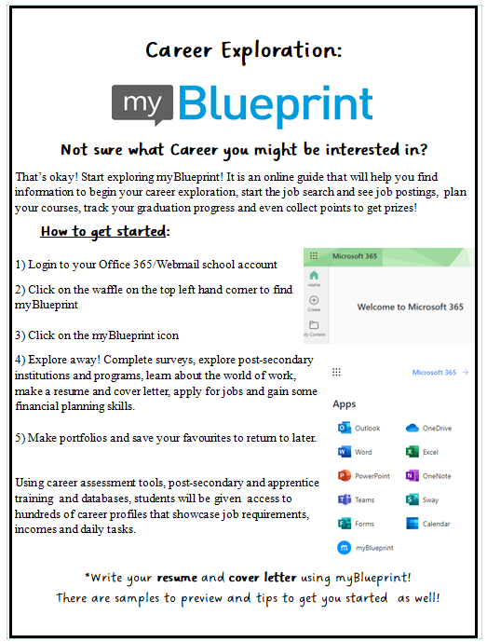

Slide 13
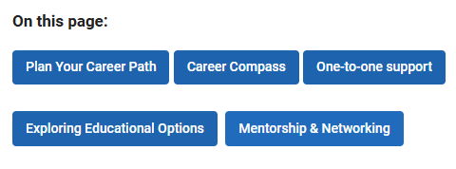
Career Planning Resources:
Career planning | Career Services | University of Manitoba (umanitoba.ca)

Slide 14
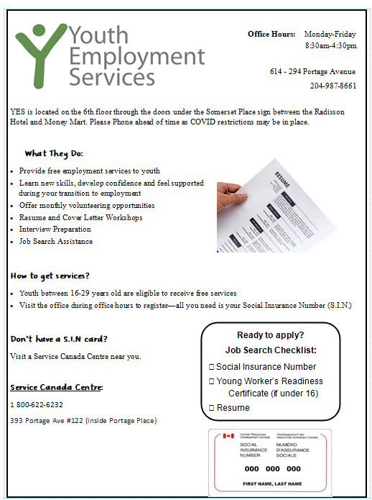
Finding a Part or Full-Time Job
It’s always a good idea to look on specific company websites if you know where you want to work. Hand in resumes at places you want to work, and they will generally keep them on file until they are hiring again.
Check out:
Youth and student employment - Canada.ca
Public Service Commission | Province of Manitoba | STEP Services (gov.mb.ca)
http://ca.indeed.com
http://www.jobbank.gc.ca
Home - Youth Employment Services (yesmb.ca)
*Hiring firms such as
Pinnacle Staffing Agency | Manitoba, Winnipeg Jobs | Executive Search can also help

Slide 15


COLLEGE & UNIVERSITY
University Entrance – You must have 5 40S/42S level classes. Phys Ed does NOT count towards the 5
Recommended Application Deadlines
U of M, U of W, USB, CMU: March 1st
U of M Faculty of Music: January 15th / U of M Leader of Tomorrow Scholarship: December 1st
RRC/MITT : varies
OUT-OF-PROVINCE: VARIES

Slide 16
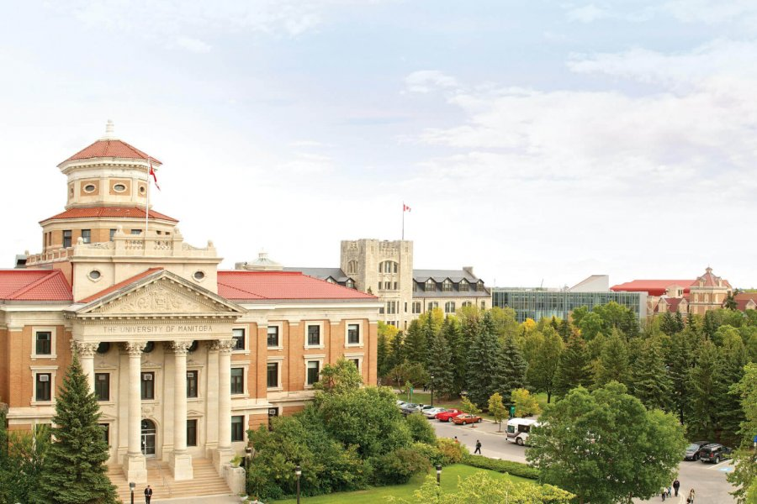
University of Manitoba
Fall Open House: Oct. 28th, 2025 5:30 - 8:30 P.M. In Person
Fall Virtual Open House: Nov. 12th, 2025 3:00 - 8:00 PM
Open House | Explore UM | University of Manitoba

Slide 17
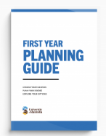
University of Manitoba- Useful Websites
Admission Requirements (U1 and Direct Entry): 2025-um-viewbook.pdf
To get more information on direct entry and planning courses for your first year, please see the First Year Planning Guide: First Year Centre | University of Manitoba
Academic Course Guide (courses highlighted in blue can be used for entrance scholarship consideration): 40s-coursescholarship-list-100721.pdf (umanitoba.ca)
How to Apply: https://umanitoba.ca/explore/undergraduate-admissions/learn-how-apply

Slide 18
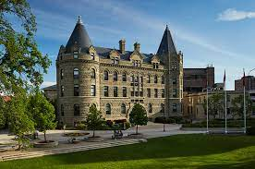
University of Winnipeg
Future Student Night: November 25th, 2025, 5:30-8:30 P.M.
Here is the link to register. Event Summary

Slide 19

University of Winnipeg- Useful Websites
How to Apply (includes video tutorials): Ready to Apply | Future Student | The University of Winnipeg (uwinnipeg.ca)
Academic Program Fact Sheets (includes a description and which high school pre-requisites you may need to have): Factsheets | Factsheets | The University of Winnipeg (uwinnipeg.ca)
Undergraduate Viewbook: 2025-2026 Undergrad Domestic Viewbook (uwinnipeg.ca)

Slide 20

CMU (Canadian Mennonite University)
Thursday, February 19, 2026 starting at 5:00 PM. No registration required but encouraged! Registration coming soon.
November 20–22, 2025 | 7:00 PM Thursday – 2:00 PM Saturday
March 26–28, 2026 | 7:00 PM Thursday – 2:00 PM Saturday
Discover Days | Experience Our Campus | CMU
NOTE: New! B.Ed – Education Program

Slide 21
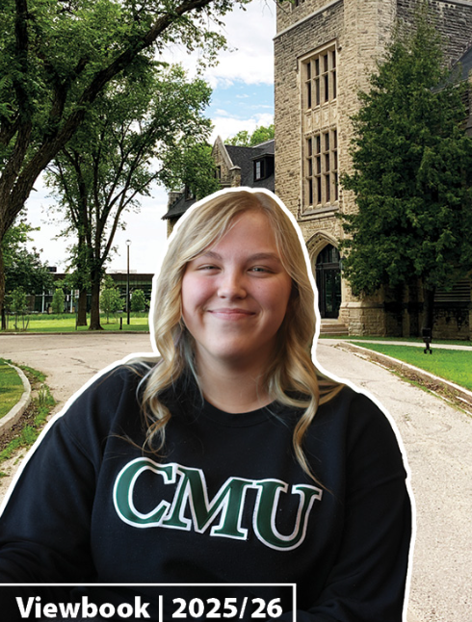
CMU – Useful Websites
How to Apply (includes virtual campus tour):CMU Undergraduate Admissions | CMU
Academic Program Overview (includes a description and which high school pre-requisites you may need to have): Undergraduate Programs in Winnipeg, Manitoba | Academic Studies | CMU
Undergraduate Viewbook:Viewbook | Admissions | CMU

Slide 22
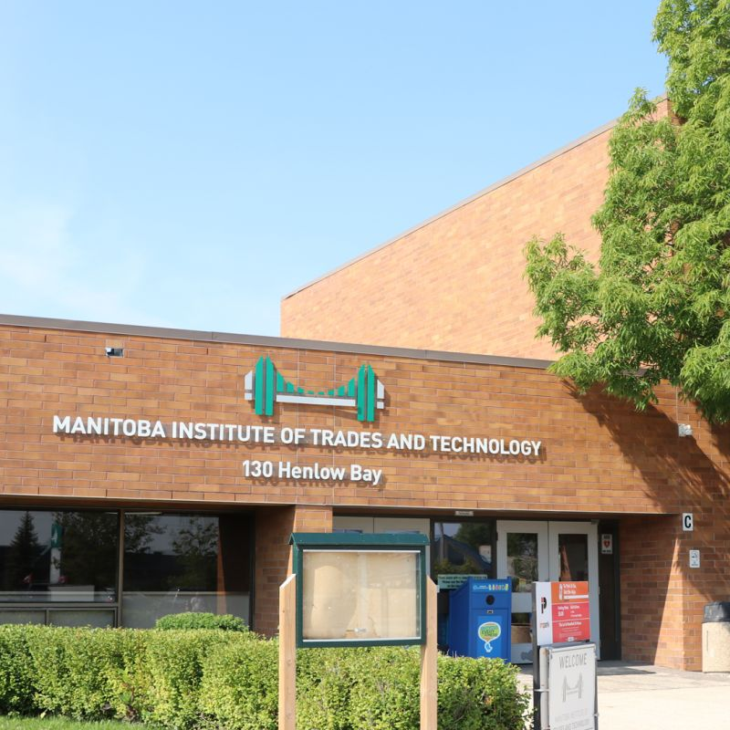
MITT (Manitoba Institute of Trades and Technology)
Open House 2026:
Thursday, February 19th 4:30-7:30
Open House - MITT

Slide 23

MITT - Useful Websites
How to Apply (includes important deadlines):
Apply | Manitoba Institute of Trades and Technology (mitt.ca)
Academic Program Overview (includes a description, video, and which high school pre-requisites you may need to have): Post-Secondary Certificate and Diploma Programs | Manitoba Institute of Trades and Technology (mitt.ca)

Slide 24

Université of St. Boniface- Useful Websites
Admission Requirements: exigences-dadmission-des-programmes.pdf (ustboniface.ca)
Viewbook: brochure.pdf (ustboniface.ca)
Profil Linguistique – a language placement assessment that accepted students must take: Profil linguistique en français - Université de Saint-Boniface (ustboniface.ca)
Request a personalized tour: In-person Tour! - Université de Saint-Boniface (ustboniface.ca)

Slide 25


Reserved Spaces for USB Students
A Path to Medicine: A Path to Medicine - Université de Saint-Boniface (ustboniface.ca)
U Ottawa admits up to 8 students from outside of Ottawa and Quebec for French Speaking Students - NO MCAT REQUIRED. USB students are well-positioned to get these spots. (Note: U of M holds 3 spots for French Speaking students – subject to MCAT)
A Springboard to Common Law: https://ustboniface.ca/en/law
USB has 4 spaces reserved in the Common Law programs at UOttawa and 4 in UMoncton in French for graduates from Bachelor of Arts or Bachelor of Science programs. Assessment is application-based, LSAT is not required for admission!
NURSING is direct entry at USB!! (different than other programs in Manitoba)

Slide 26
St Boniface – Important Dates
Early October 2025 : Online application for Fall 2026 opens
Wednesday, November 12, 2025: USB Open House on campus Open to the public: 5pm – 7:30pm
Saturday, November 29, 2025: Careers in Healthcare in French (collaboration with uOttawa)
Tuesday, February 10, 2026: Discovery Day: Education
Wednesday, February 11, 2026: Discovery Day: Nursing
February 23 - 27 (Monday - Friday), 2026: Student for a Day
March 1, 2026: Application deadline to be eligible for automatic entrance scholarships

Slide 27

Red River College Polytech
Open Doors: February 18th, 2026 rrc.ca/opendoors
Online and in-person information sessions: Future Student Events : RRC Polytech: Future Student Events

Slide 28
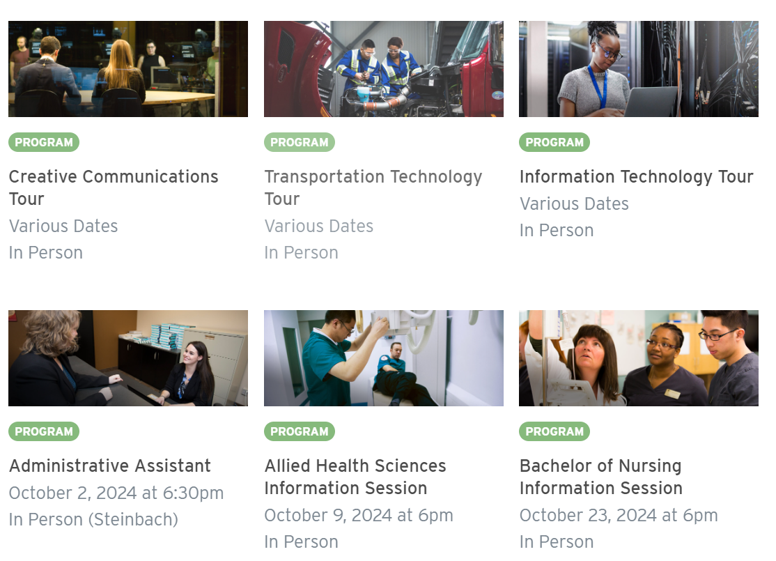
Red River College Polytech - Useful Websites
Virtual Viewbook: RRC Polytech’s Viewbook : RRC Polytech: Student Recruitment
Program Explorer: RRC Polytech: Program Explorer
Application Deadlines: Application Deadlines : RRC Polytech
Application Process: Application Processes : RRC Polytech
Personalized Campus Tours: Campus Tours : RRC Polytech: Future Student Events

Slide 29
Other Manitoba Universities
Brandon University
Booth University
Providence University College

Slide 30
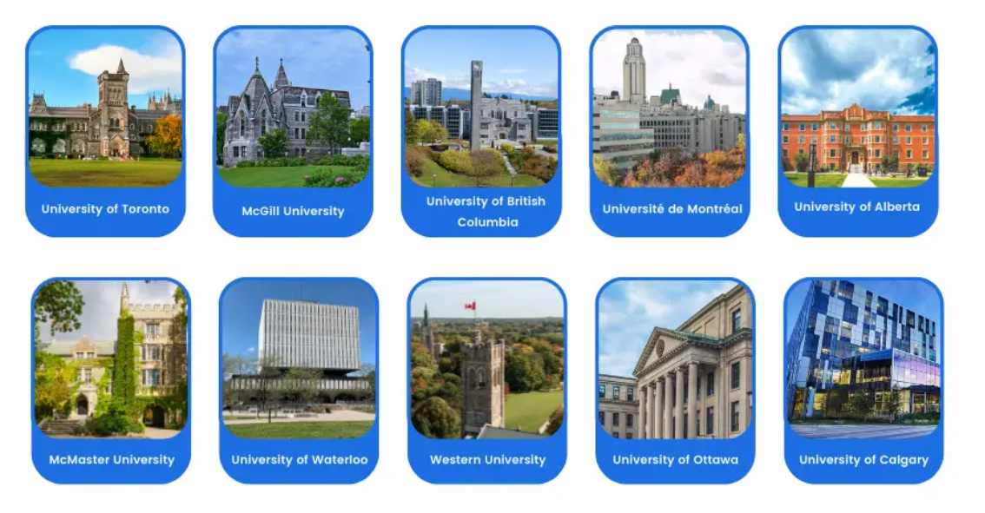
Going to University or College Outside of Manitoba?

Slide 31


Deadlines differ than Manitoba. CHECK WITH YOUR INSTITUTION!
Applying to the University of British Columbia? Applicants must fill out a personal profile that outlines their community involvement: Personal Profile
Applying to any Universities in Ontario (Toronto, York, Waterloo, Western, etc.)?
Applications must go through the Ontario Universities Application Centre (OUAC) using form 105 D (ideal completion date of OUAC form: Nov. 1st): Application Guide
Some math and science-based programs will require applicants to take Advanced Math Calculus in addition to Pre-Calculus. Check admission requirements early!
If you are applying to university in the United States you may need to write the SAT or ACT early in your grade 12 year (check with your university of choice, some are no longer requiring entrance exams). You may want to consider taking an SAT prep course ahead of time. The SAT – SAT Suite | College Board

Slide 32

YOU ARE NOT ALONE!
Connect with all of the amazing Student Support Opportunities!
Indigenous Student Support
U of W: Home | ISSC | The University of Winnipeg (uwinnipeg.ca)
U of M: Student experience | Indigenous | University of Manitoba (umanitoba.ca)
RRC: RRC Polytech: Indigenous Education
International Students and Newcomer Support
U of W: Student Initiatives | IRSS | The University of Winnipeg (uwinnipeg.ca)
RRC: RRC Polytech: Centre for Newcomer Integration
Accessibility Services (Get in touch with them before you start! - ideally 6+ months)
U of W: Home | Accessibility Services | The University of Winnipeg (uwinnipeg.ca)
U of M: Accessibility for students | University of Manitoba (umanitoba.ca)
RRC: RRC Polytech: Accessibility for Students
Counselling Services
U of W: Counselling | Student Wellness | The University of Winnipeg (uwinnipeg.ca)
U of M: Student Counselling Centre (SCC) | University of Manitoba (umanitoba.ca)
RRC: RRC Polytech: Counselling

Slide 33

CONSIDERATIONS for when APPLYING
TIPS AND TRICKS
Self-Reporting Grades
Transcripts
Proof of English Language Proficiency
AP Credits

Slide 34

Tips and Tricks for APPLYING (October to March 1st)
Have your MET # with you (this is different from your RETSD Student Number). Can be found on your report card or you can ask a teacher or Student Services Representative.
Pay the application fee. Non-refundable. Typically ranges from $100-$150.
When setting up an account with the university or college, use a PERSONAL EMAIL (not your RETSD student email).
Make note of and remember passwords.
Submit supporting documents when requested by the Admissions Office (through the application portal).
Check your portal or email regularly. You may need to submit documents or accept offers.
Most Manitoba institutions will request your transcript from the school division on your behalf if you APPLY BY MARCH 1st. If you apply after this date, or are applying to colleges or out of province, you will be responsible for submitting this.

Slide 35

Self-Reporting Grades
Self-reporting grades is part of the admission process. This involves submitting your FINAL or EXPECTED FINAL GRADES in order to be evaluated for admission.
When you apply for Admission online a drop-down list of all of the Grade 12 high school courses in Manitoba will appear. Select the Grade 12 courses you have taken or are currently taking and enter your marks.
The marks submitted will be either completed (final), or anticipate completing in the current year (expected). If you are not admissible on self-reported grades, you will be re-evaluated when the University receives official final Grade 12 information from the high schools in June/July.
TIP: Estimate your final grades based on how well you did in similar courses in Grade 11, if you have received interim Grade 12 marks, or how well you are doing in the course so far, based on tests or papers you have done.

Slide 36
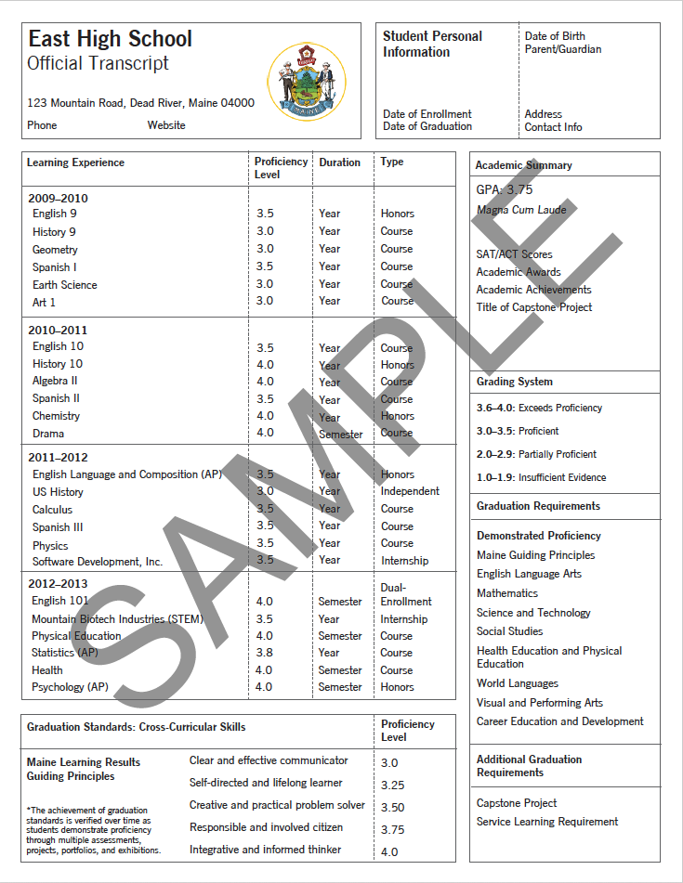
Transcripts
Transcripts: Mid-Term & Final marks are submitted to universities in our province by our School Division -students do not need to submit a transcript (as long as you apply by the March 1st deadline date). They will request transcripts in...
April: First Semester final grades & Second Semester mid-term grades
June: Final grades
IMPORTANT: Conditional offers and Entrance Scholarship offers are based on April transcript. Final transcript is reviewed to ensure marks are maintained. Scholarship offers may or may not be re-assessed. (DEFFERED- entrance for a year)
OUT OF PROVINCE INSTITUTIONS AND LOCAL COLLEGES: You will need to request and submit transcripts on your own.
NOTE: To request a transcript, you will ask for this in the main office. Due to our shift to a new system, they are only printing these on Fridays and it will take up to a week to get your transcript.

Slide 37
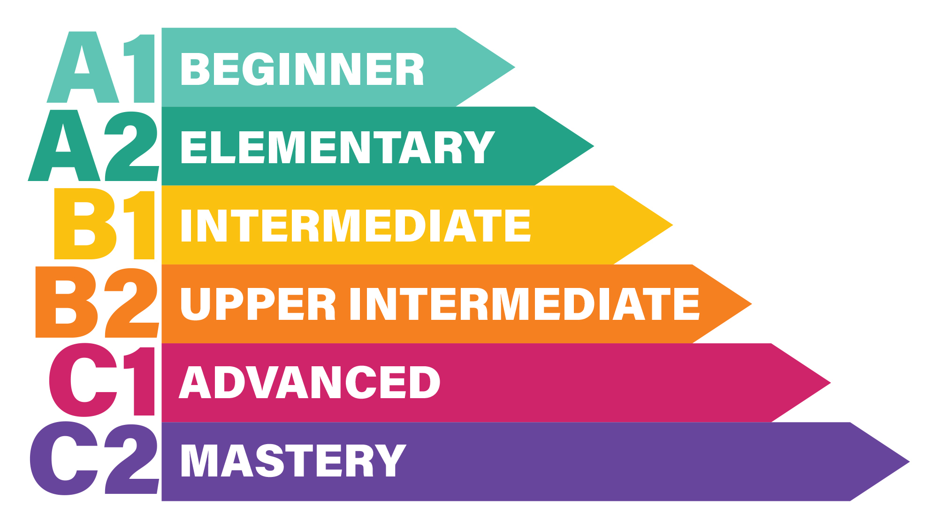
Proof of English Language Proficiency
If English is not the student's first/primary language and they are not from an English Exempt Country (see next slide), they must provide supporting documentation to show they meet one of the conditions below. Students will not be admitted until this requirement has been met.
1. Ten consecutive years of residency in Canada that may include years of study in Canada. The period of residency will be the time elapsed between the "Landed On" date on the Record of Landing Document and July 1 of the year of application, or
2. Three years of full-time education in English at secondary (high school) or post-secondary (university or college) levels in Canada, or
3. Graduation from a Manitoba high school with at least one Senior 4 Core English credit with a minimum grade of 70% (U of W) or 75% (U of M) (Comprehensive Focus, Literary Focus or Transactional Focus) (NOTE: For RRC you need 2 Grade 12 English Classes, with a minimum average of 75%)
4. Completion of an English language test such as DuoLingo or IELTS (minimum score required)
FOR MORE INFORMATION:
U of W: English Language Requirements | Future Student | The University of Winnipeg (uwinnipeg.ca)
U of M: English language proficiency requirements | Explore UM | University of Manitoba (umanitoba.ca)
RRC: English Language Requirements (ELR) :: RRC Polytech Program & Course Catalogue

Slide 38
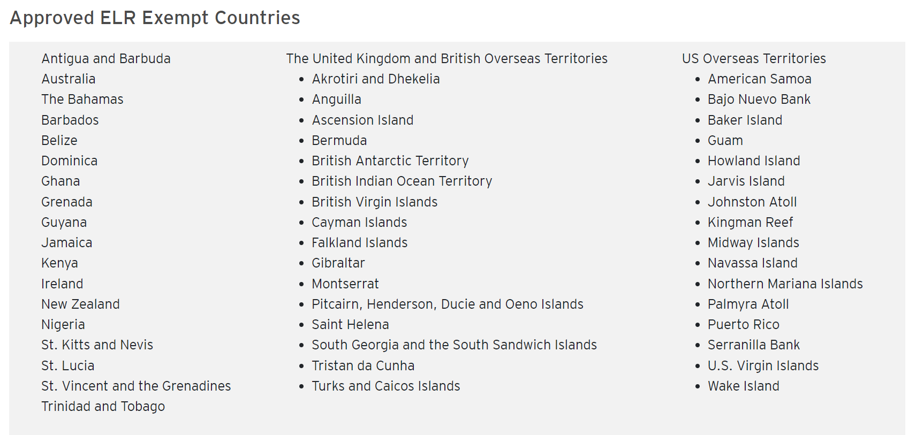
Examples of English Exempt Countries
NOTE: This list will vary by institution. Double check the institution's website.

Slide 39
How does AP credit transfer work
for Universities?
Visit your chosen institution's website →
Your AP Credits are eligible for university credits if your marks are strong enough. Even if strong enough, it is your choice if you want the credits to be transferred.
They are not automatically transferred. You must complete a form along with your official copy of your results.
U of W: Advanced Placement (AP) and International Baccalaureate (IB) Information | Future Student | The University of Winnipeg (uwinnipeg.ca)
U of M: Transfer credit information | Explore UM | University of Manitoba (umanitoba.ca)
USB: Advanced Placement - Université de Saint-Boniface (ustboniface.ca)
CMU – page 2: Recommendation regarding Transfer Credit for International Baccalaureate Courses (cmu.ca)

Slide 40
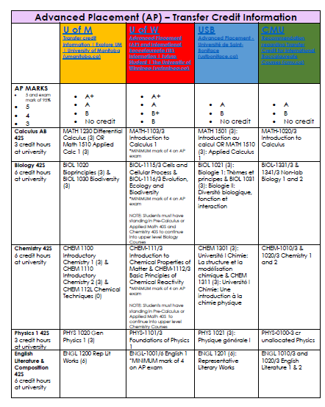

Slide 41


Specialized Training: Colleges, Trade Schools, & Continuing Education

Slide 42

APPRENTICESHIP

Slide 43

Apprenticeship Manitoba
Why consider becoming an apprentice?
There are over 55 trade programs in Manitoba: Province of Manitoba | aesi - Manitoba Trades (gov.mb.ca)
Being an apprentice fast-tracks you into Red River College Polytech
Most trades offer great salaries, and you get to earn while you learn and begin your post-training life with little to no debt.
If you complete all your training, you will be able to write an exam that certifies you to work anywhere in Canada, called a red seal exam.

Slide 44

Apprenticeship Manitoba
How do you become an apprentice?
You must find a professional in the field you’re interested in that is willing to train you. Once you find someone to take you on as an apprentice, you and your employer fill out an application form, which can be found at:
Province of Manitoba | aesi - Apprenticeship Manitoba (gov.mb.ca)
Then you start working, earning money and hours toward your Level 1 certification! Most trades require about 1800 hours of experience per level and have between 2 and 4 levels.

Slide 45

Fire & Paramedic college
Location – Brandon
Approx Cost - $10,000 plus $4,000 for books and supplies
Must provide your own living accommodations
Application Deadline: March 7th
Program Information: 2025-intake-program-information.pdf
Application Information: 2025-intake-application-information-20250131.pdf
As for educational, is that in addition to Grade 12 English, and either one of Grade 12 Chemistry or Physics, there will be a new pre-requisite for our program that requires students to have 6 credit hours (plus a lab component) of Anatomy & Physiology.

Slide 46

Funding Your Education
External Scholarships and Awards
Internal Scholarships and AWARDS
Student AID
Tuition Waiver
Sponsorship and Government Funding – Indigenous Students

Slide 47

External Scholarships, Awards & Bursaries
How do I find scholarships?
Make sure you apply to university in time to be eligible for automatic entrance scholarships! Do a thorough search of all the scholarships, awards and bursaries available at the university/college you are planning to attend.
Check out Winnipeg School Division’s list of scholarship, organized by deadline month: Scholarships (winnipegsd.ca)
Check out Futures Forward Scholarship Guide – Scholarships for Students from Care, Indigenous Students, Scholarships and Bursaries Open to All, Sponsorship and Government Funding: 2025-Scholarship-Guide.pdf
Make an account on a scholarship search site like:
https://scholartree.ca/
https://www.scholarshipscanada.com/
https://yconic.com/
Indspire Home - Indspire

Slide 48
Entrance Scholarships for Post-Secondary
***Apply by March 1st to be automatically considered for Entrance Scholarships based on Grades (85% average or higher based on 5 best 40S level classes)
University of Manitoba:
Entrance awards | University of Manitoba (umanitoba.ca)
****Note: There is a set list of 40S courses that are eligible for scholarship, while others are not. Please review this list to ensure you would qualify. If not, reach out to your Student Services contact to discuss further. 40s-coursescholarship-list-100721.pdf (umanitoba.ca)
**** You may want to consider the Leader of Tomorrow or Indigenous Leader of Tomorrow Scholarship – application due December 1st
University of Winnipeg:
Entrance Awards (first-year students) | Awards | The University of Winnipeg (uwinnipeg.ca)
***Also has some Application-Based Required Entrance Scholarships – complete the application form (opens in November) by March 1st to be considered
Université de St. Boniface:
Entrance Scholarships - Université de Saint-Boniface (ustboniface.ca)
Red River College:
Awards, bursaries, and scholarships :: RRC Polytech Program & Course Catalogue
Canadian Mennonite University:
Academic Scholarships for New, Returning, and Transfer Students | Undergraduate Scholarships & Awards | CMU
Manitoba Institute of Trades and Technology:
MITT Bursaries Scholarships and Awards | Manitoba Institute of Trades and Technology

Slide 49
Tips For Applying For Awards, Scholarships & Bursaries
Get started early.
Be accurate and complete.
Be personal and specific.
Proofread your application.
Choose your references carefully.
Give your references time (min. 2 weeks)
If needed, request your transcript from the office early. Save it as a PDF.
Thank your references!
Keep your contact information current.
Check your email account frequently.
Continue trying.
Watch for Deadlines!
Ask for help if needed.

Slide 50
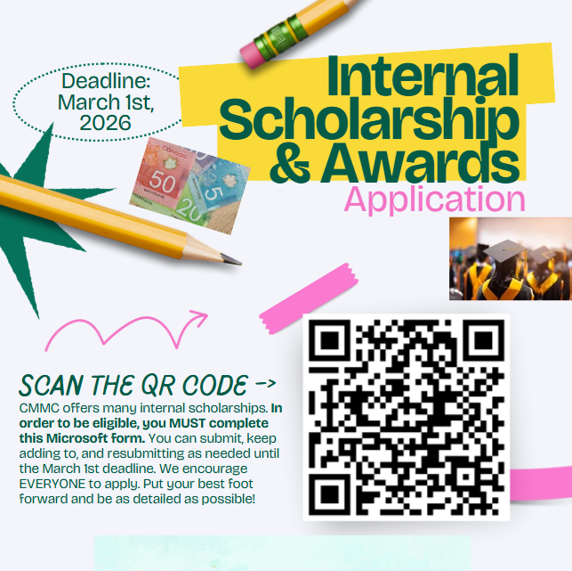
Internal Scholarships & Awards
CMMC offers many internal scholarships.
This form will be editable so you can continue adding to it.
Completing this one form allows you to be eligible for consideration for the many awards we offer. NOT BASED SOLELY ON ACADEMICS
Complete this form (QR CODE OR LINK) by March 1st to be considered for internal scholarships!

Slide 51


Canada-Manitoba Integrated Student Aid
Manitoba Student Aid administers provincial and federal financial assistance for post-secondary studies in the form of loans, grants and bursaries for eligible applicants.
You can apply for both federal & provincial assistance in one application, directly with Manitoba Student Aid.
https://www.edu.gov.mb.ca/msa/
MB Student Aid Overview: Manitoba Student Aid Presentation (gov.mb.ca)

Slide 52

Benefits of Student Aid
Not just a loan. There are many non-repayable grants & bursaries that they will automatically assess your eligibility for
0% interest & interest-free repayment
No payments required while you are a full-time student
Repayment assistance available if you are experiencing financial hardships

Slide 53

FUTURES FORWARD - Tuition Waiver Program
Ten colleges and universities in Manitoba offer a limited amount of Tuition Waivers for current and former youth-in-care
Bursary may cover the tuition of a certificate, diploma or undergraduate program
Tuition Waiver students are also eligible for Living Supports through Workforce Training & Employment (WTE) to sponsor books, supplies and a biweekly living allowance
Deadline: March 31st
Paying for Post-Secondary School | Futures Forward

Slide 54

Indigenous Students:
Sponsorship & Government Funding
Financial sponsorship for eligible Indigenous students with Status and eligible Inuit students may include tuition, fees, mandatory books, supplies and allowance. Contact your band’s local office for application forms and deadlines: Post-Secondary Student Support Program (sac-isc.gc.ca)
Métis and Non-Status and Inuit students are advised to contact the Manitoba Métis Federation’s Métis Employment & Training to check eligibility: Métis Employment & Training | Manitoba Métis Federation (mmf.mb.ca)
Check out the Indspire Bursaries and Scholarships: Bursaries & Scholarships | Indspire
Check out the following guide for other scholarship and funding opportunities for Indigenous Students: 2024-2025-Scholarship-Guide.pdf (futuresforward.ca)

Slide 55



GAP YEAR

Slide 56

Travel Opportunities for Students
Sites to get you started:
Canada World Youth (volunteer exchange programs): Canada World Youth | Volunteer Forever
SWAP (Live and work abroad): www.swap.ca
Explore Program (Five-week French language bursary program): www.myexplore.ca
Volunteer Eco Students Abroad: Volunteer Eco Students Abroad | Volunteer Forever
Teach English Overseas: www.globaltesol.com
Student Exchange Programs: https://asse.com/
WWOOF (live and learn on organic farms worldwide): http://wwoof.net/
Volunteer and Intern Abroad: www.projects-abroad.ca

Slide 57


Slide 58
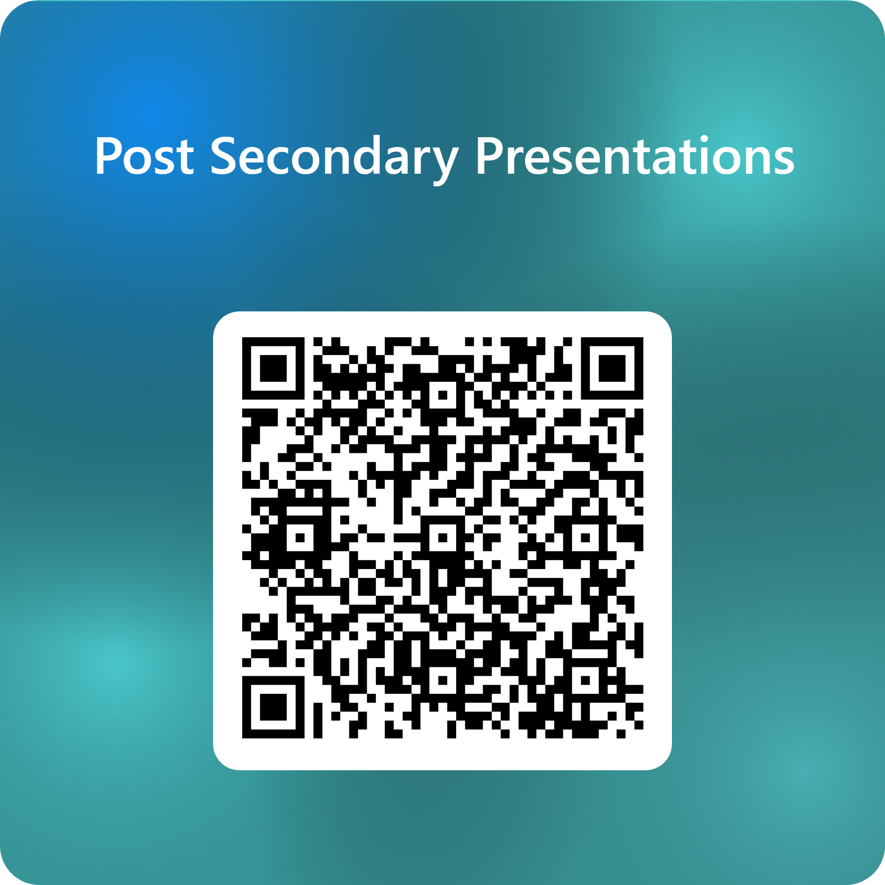
Further Questions?
Please contact Ms. Amato or Mr. Schreyer
Period 1 (8:30–9:30 a.m.):
October 20 – University of Manitoba
October 27 – University of Winnipeg
October 31 – Université de Saint-Boniface
November 5 – Red River College Polytechnic
Sign up on the FORMS

