Slide 1
CMMC INTERNAL SCHOLARSHIP APPLICATION
2023-2024

Slide 2
INTERNAL Scholarships
Every year several community members and organizations donate hundreds of dollars in scholarships to be given exclusively to CMMC graduates.

Slide 3
application process
To be considered for Internal Scholarships students MUST:
Fill out an ONLINE APPLICATION
Submit the application by the MARCH 1ST DEADLINE

Slide 4
details
Access the application by following the QR code that will be posted at the end of this presentation and on the GRADE 12 TEAMS page.
You will be asked questions about your post-secondary plans, your involvement in both the school and community and personal information.
Please remember that all questions are OPTIONAL.
Read each question carefully and follow the PROCESS outlined in the questions on how to record your answers.
If information is not filled out accurately, your application may be sent back to you.

Slide 5
PROCESS
Access the application by following the QR CODE that will be posted at the end of this presentation and on the GRADE 12 TEAMS page.
Read each question carefully and follow the PROCESS outlined on how to record your answers.
If details are not recorded accurately, your application will be sent back to you to revise.
Please remember that all questions are OPTIONAL.

Slide 6
example
ACTIVITIES INVENTORY: VOLUNTEERING
Use the following format to enter your details:
ACTIVITY > SCHOOL YEARS > DURATION (hours/week & length of time in months of year) > DETAILS (Organization/Position/Responsibilities/Leadership/Awards) > SCHOOL (S) or COMMUNITY (C)
EXAMPLE: Boys & Girls Club > 11-12 > 3hrs/wk (September-June) > Mentor elementary aged students. Responsible for planning activities. > C

Slide 7
references
If applicable, please provide the names of 2 references (one from the school and one from the community) that can speak to your contributions towards volunteerism, clubs, sports, etc.
NAME OF REFERENCE > NAME OF ORGANIZATION/CLUB/SPORT > CONTACT INFORMATION

Slide 8
SENSITIVE INFORMATION
Many awards are based on FINANCIAL NEED and OVERCOMING SIGNIFICANT ADVERSITY
Answering these questions is OPTIONAL

Slide 9
Financial need
If finances are a significant barrier for your family and will affect your ability to pursue post-secondary education, you will be asked to share details.
Family's annual gross income range
If you have more than one parent or guardian, please combine their incomes. If your parents/guardians live in separate households, please combine their incomes.
Other important details

Slide 10
Perseverance & overcoming adversity
If applicable, you will be asked to share your personal story of adversity you've been dealing with or have overcome.
CONFIDENTIAL - Information will remain confidential amongst scholarship committee members.
Questions or concerns? Please see Mrs. Morran

Slide 11
Selecting scholarships
Carefully read over the criteria for each award listed
Apply ONLY for the awards you qualify for

Slide 12
deadline
The deadline to be considered for Internal Scholarships is MARCH 1ST, 2024.
No late applications will be accepted.
ADDITIONAL INFORMATION – You will continue to be involved in activities after March 1st. The portal will remain OPEN to students who have met the deadline. You will be able to add new information as the year continues.

Slide 13
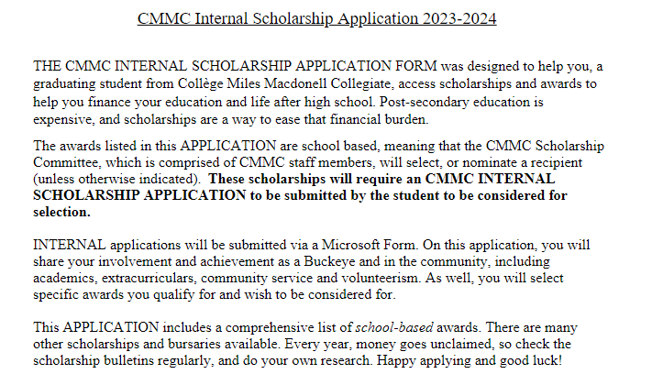
Parent mailout

Slide 14
Questions
Please see Mrs. Morran if you have any questions or concerns.

Slide 15
APPLICATION ACCESS
https://forms.office.com/r/Bcwkq9UhEx

