Slide 1
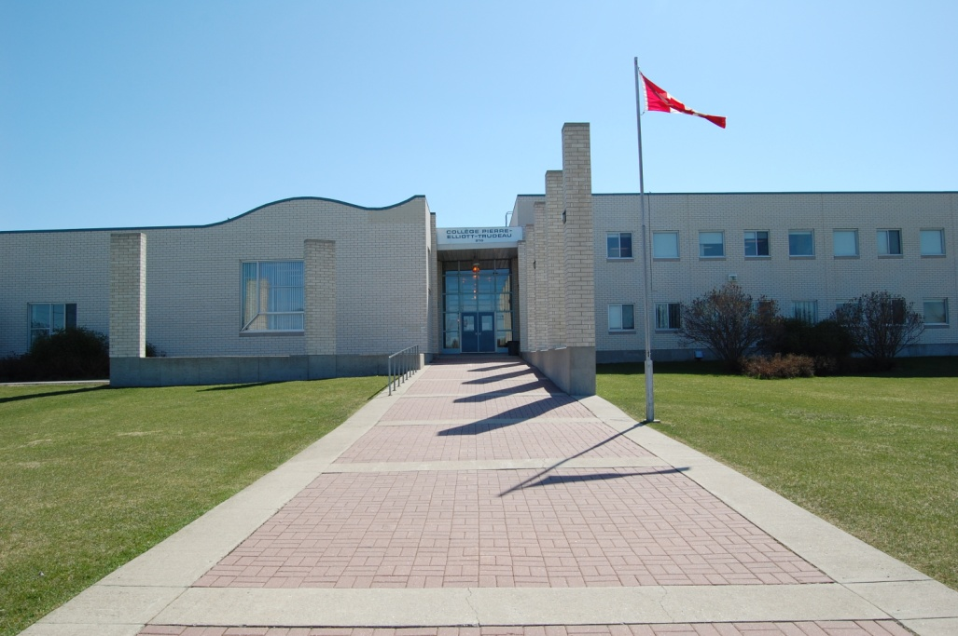
Collège
Pierre-Elliott-Trudeau
2023

Slide 2
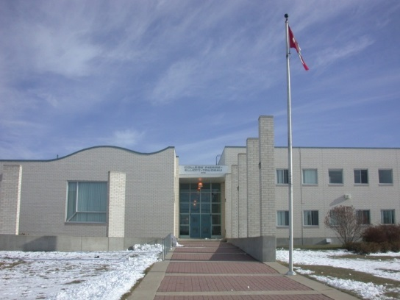
Demographics
370 students from grades 9-12
25 staff members
Main feeder schools are École Regent Park and École Dugald School.

Slide 3

History
Located on Treaty One land
Opened in 1990 as the first French Immersion high school in the former Transcona-Springfield School Division.
Became one of six high schools in the River East Transcona School Division at Amalgamation in 2002.

Slide 4

CPET…
…is a French immersion milieu centre.
All courses, other than English and Music, are taught in French.

Slide 5

CPET…
…is a UNESCO ASPnet International School

Slide 6
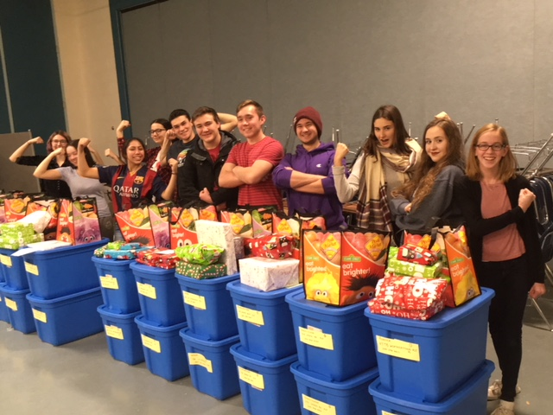
Mission
The school's mission is to develop proud Canadian bilingual learners while fostering a student appreciation for education, French, social justice, and for his or her own identity as a young adult in the contemporary world.

Slide 7

School Goals
To enhance the acquisition and awareness of the French language and culture within our students.
To promote caring, safe and inclusive schools with the divisional Positive behaviours and Intervention Strategies residency program.
Enhance numeracy and literacy as per our Divisional priorities.
As a UNESCO ASPnet school, promote a culture of peace and respect.
Notes:
.

Slide 8
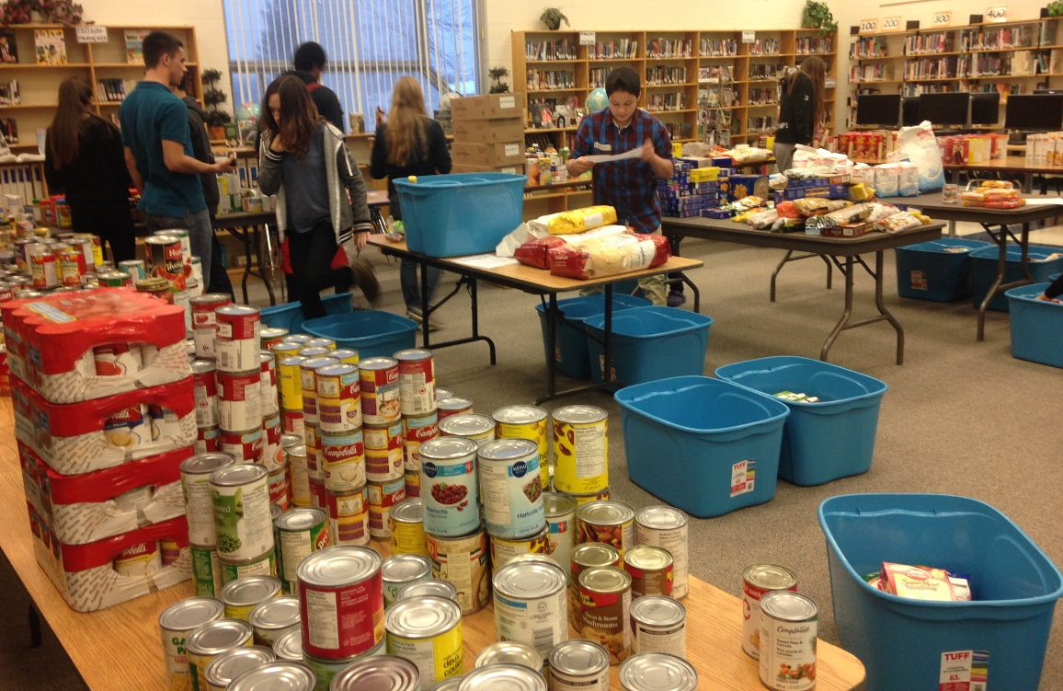
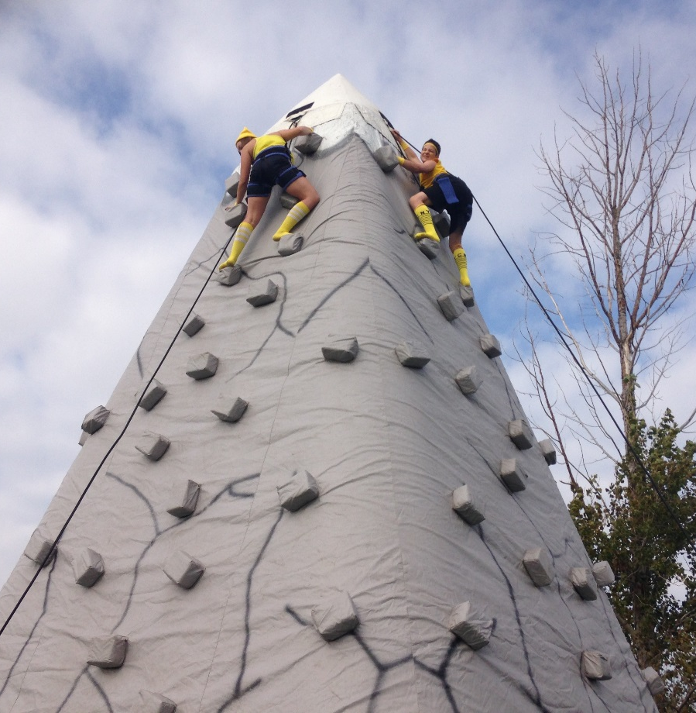
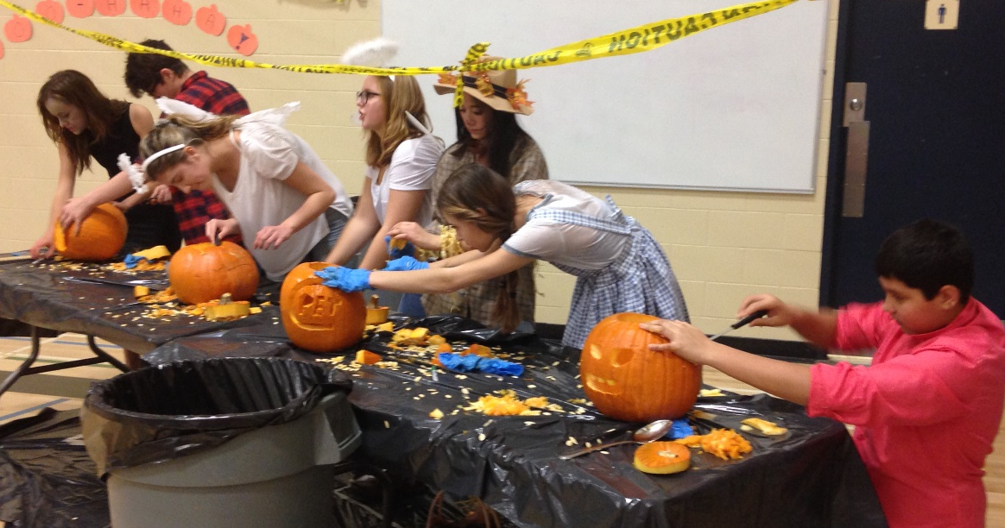
Student Committees:
Student Council

Slide 9
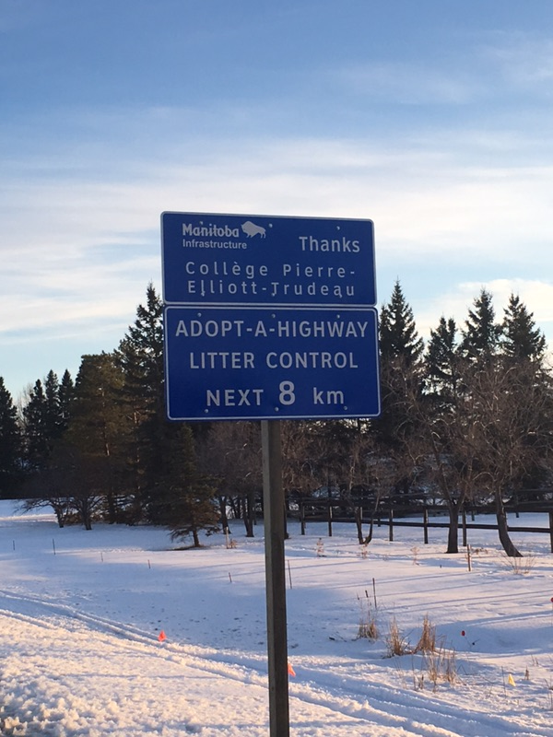
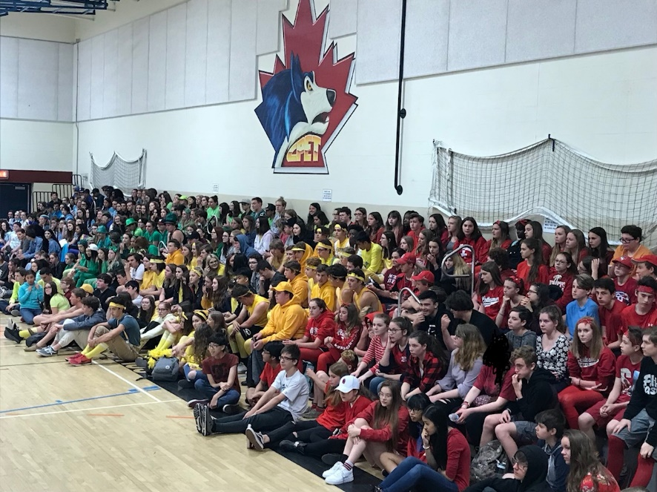
Student Council Possible Activities
L'Association des étudiants du collège Pierre-Elliott-Trudeau
School fundraisers
Assemblies
Year End Barbecue

Slide 10


Yearbook Committee
Responsible for collecting photos and planning Yearbook layout.

Slide 11

UNESCO ASPNet Committee:
  Students meet approximately once a week
  Student-directed and teacher-facilitated
  School-related activities to increase student awareness of human rights issues, promoting a culture of peace, sustainable development, and global citizenship.

Slide 12
UNESCO Committee:
  Community outreach projects include: soup kitchen, clothing drives, food drives, hygienic and educational kits for developing countries, Habitat for Humanity, …
  Friends of Stansberry, Bolivia
  1800-minute Famine
  Ethics Bowl

Slide 13

Team name: Canadiens
Mascot : Pierre le loup

Slide 14

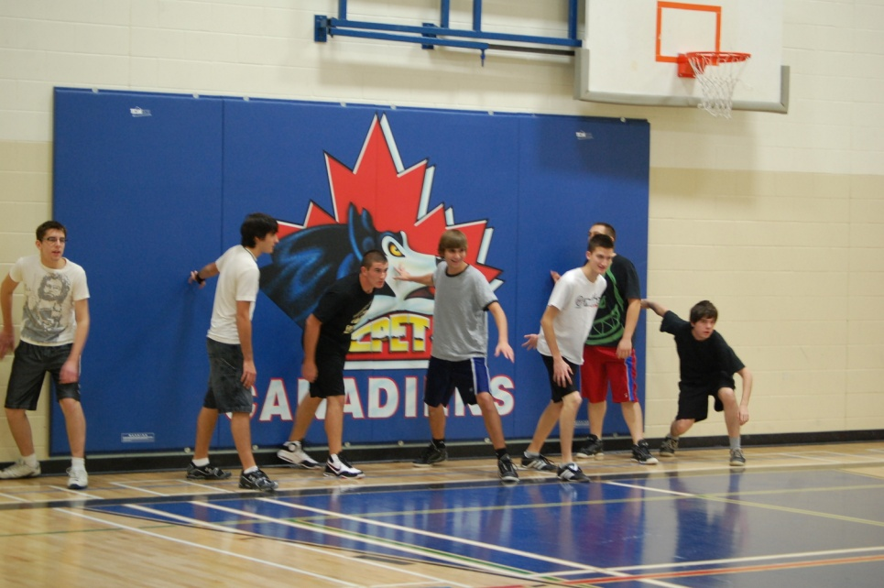
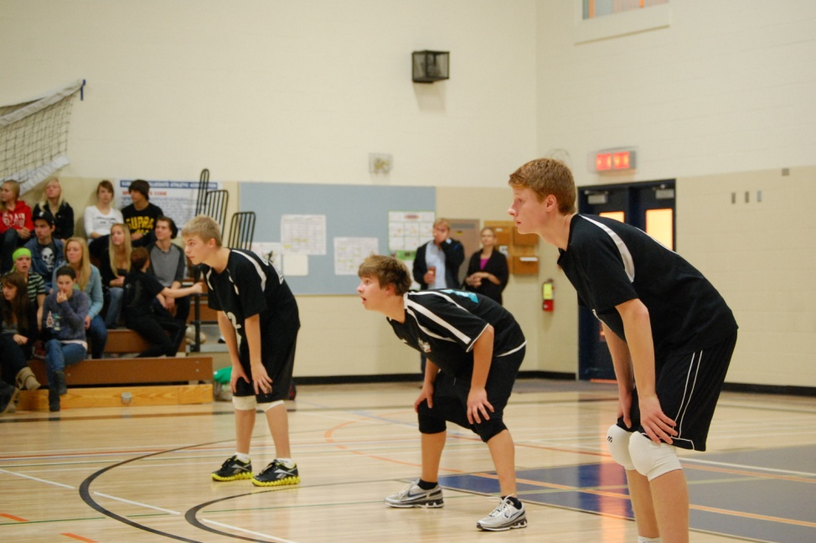
Sports
  Canadiens : Members of SCAC (South Central Athletic Conference)

Slide 15
School teams
Golf
Volleyball
Hockey
Curling
Basketball
Track and Field
Badminton
Soccer
Cross Country

Slide 16
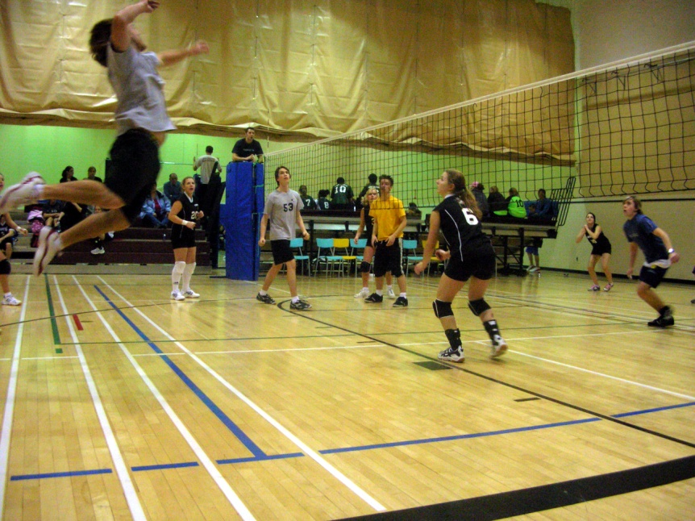
Possible Intramural Activities
Volleyball
3 on 3 Basketball
Voyageur Games
Floor Hockey
Dodgeball
Badminton
Table Tennis

Slide 17
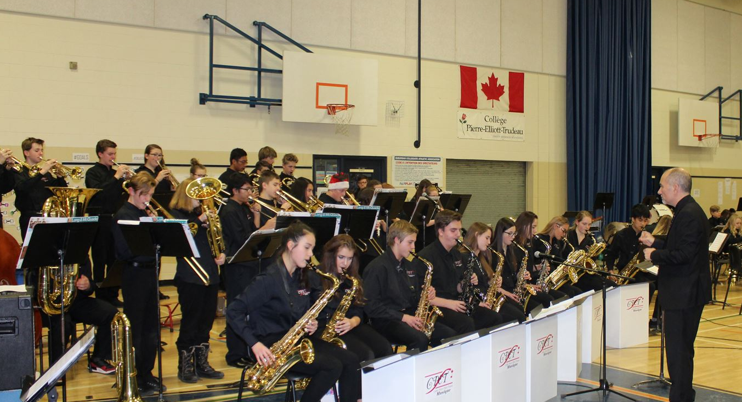
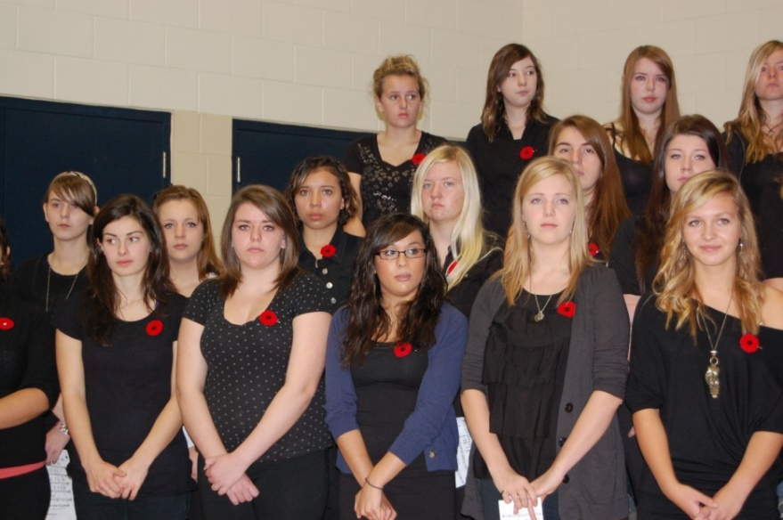
Music Program
Courses include:
Band
Jazz
Choir

Slide 18
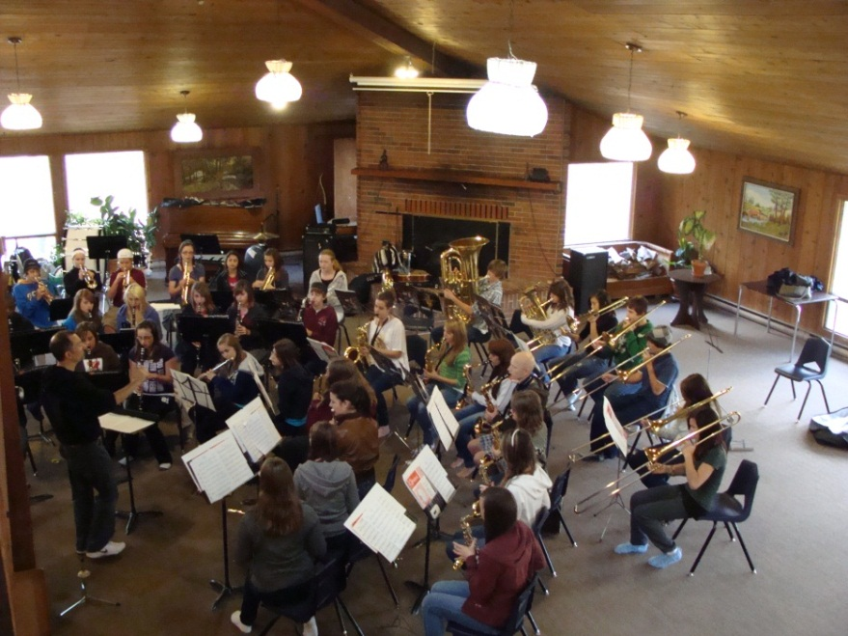
Music Program
Special events may include:
Grade 9 Fall Band Camp
Winter & Spring Concerts
Jazz Cabaret
Brandon Jazz Festival
Optimist Band Festival
Music Monday
Montreal trip

Slide 19
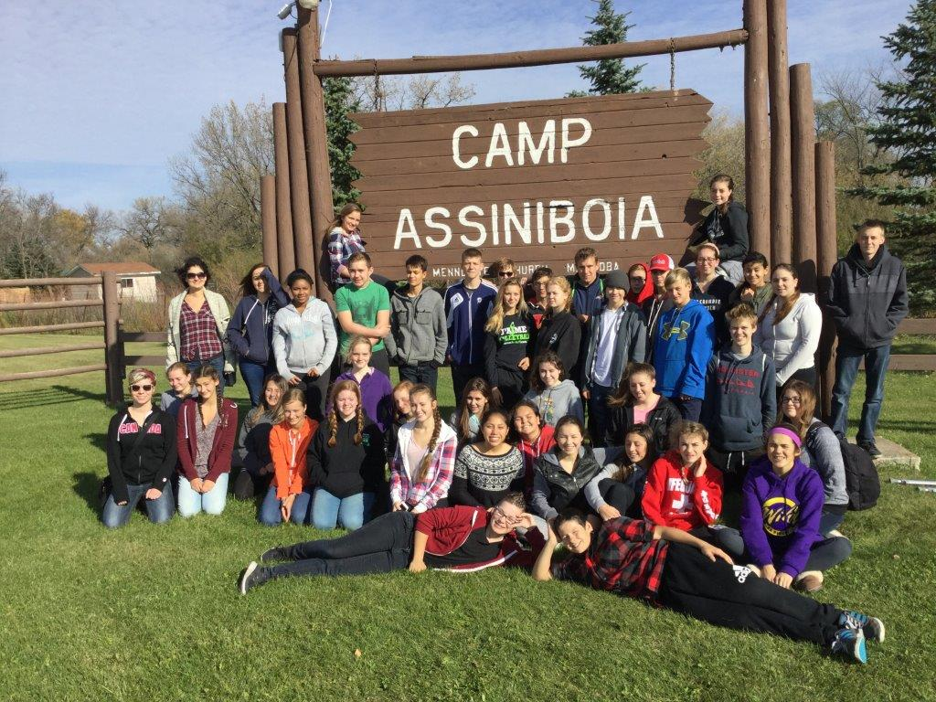
Excursions
Fall Band Camp

Slide 20

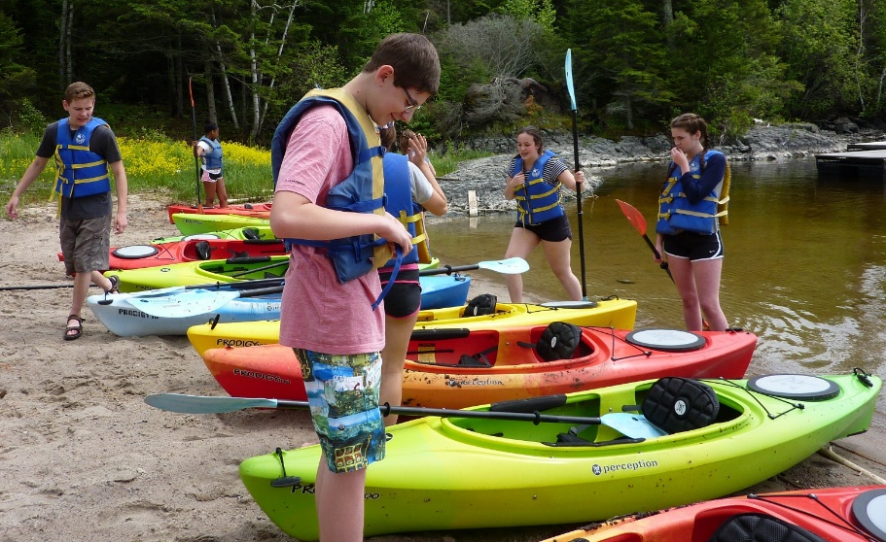
Excursions
B’Nai Brith Grade 9 Camp (Spring)

Slide 21
Excursions
Spruce Woods Hiking / Canoeing (Outdoor Physical Education)

Slide 22
Transition to high school
Question : What are some of the challenges transitioning from grade 8 Middle Years to grade 9 High School?

Slide 23
Transition to high school
Answers :
Increased academic workload
Varied teachers and expectations
Increased privileges and responsibilities
Every credit must be earned
Exams / Final assessments
Grade 9 teachers work with our Student Services team to assist students’ transition over the year.

Slide 24
Student Services :
Resource Teacher
  Homework assistance
  Test preparation
  Credit recovery
  Curriculum adaptations when required
  Classroom support
  Individual assistance

Slide 25
Student Services :
Guidance Counsellor
  Educational planning
  Vocational exploration
  Career Planning
  Personal counselling
  Grad tracking
  Schedule changes
  Bursaries and scholarships availability

Slide 26
Teacher Advisor/Homeroom Teacher
  Student orientation
  Distribution of information and documents
  Grad tracking
  Course selection
  Adult advocacy

Slide 27
Semester System
Terms 1 and 2 comprise Semester 1.
Terms 3 and 4 comprise Semester 2.

Slide 28
Daily Schedule
Five instructional periods per day (65 minutes each), identified as “periods” or “bands” (Blocs in French)
    Bloc 1: Begins 8:45
    Bloc 2 :
    Bloc 3 :
    Lunch :
    Bloc 5 : Ends at 3:25

Slide 29
Credit System:
Minimum of 30 credits to graduate:
  These 30 credits comprise compulsory and optional courses.
  14 of these courses must be instructed in French to receive the provincial French immersion diploma.
  22 of these courses must be instructed in French to receive the CPET diploma.
  Minimum of 4 40-level courses to graduate.

Slide 30
The suggested pattern for credit :
  Grade 9 = 9.5 credits
  Grade 10 = 8 credits
  Grade 11 = 7 credits
  Grade 12 = 6 credits
TOTAL = 30.5 credits*
*Students are encouraged to take more than the 30 credit requirement.

Slide 31
Grade 9 compulsory courses
  2.5 credits: Français11G/Vie Carrière(Career Development-Life/Work Exploration 10S) and Français10F
  1 credit: Mathematics 10F
  1 credit: English Language Arts 10F
  1 credit: Social Studies 10F
  1 credit: Science 10F
  1 credit: Physical Education/Health 10F
  Plus 2 optional credits
Total = 9.5 credits

Slide 32
Grade 9 Optional courses
Applying Information and Communication
Technology 1 and 2 15F
Visual Arts
Drama
Music courses
  Band 10S
  Jazz Band 10S

Slide 33
Honour Roll Criteria
Minimum of 3 courses completed in the semester
Average of 80% or higher
Minimum of 70% in each course

Slide 34

RETSD
Code of Conduct
Policies
Programming and schools
Registration information
http://www.retsd.mb.ca

Slide 35
Next Steps
The 2023 Program of Studies is posted on the CPET School Website for review.
Registration Packages are sent to MY schools for distribution to grade 8 students by January 25,2023.
Completed Registration Packages should be handed in at MY schools by March 10, 2023.
School of Choice applications are received in May and approvals or denials are communicated in June.

Slide 36
Collège
Pierre-Elliott-Trudeau

