Slide 1
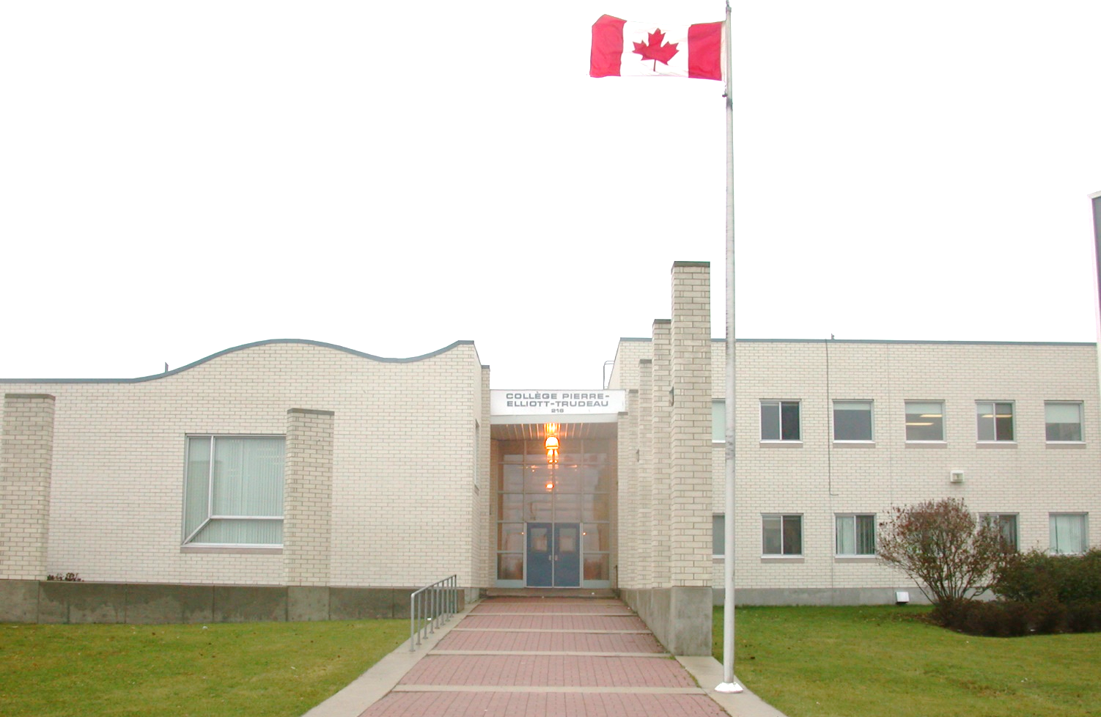
~ Home of les canadiens et canadiennes ~
Collège Pierre-Elliott-Trudeau
Portes-ouvertes (Open House)
Le 12 février, 2025

Slide 2
~ Home of les canadiens et canadiennes ~
At Collège Pierre-Elliott-Trudeau our mission is develop proud Canadian bilingual learners while fostering a student appreciation for education, French, social justice and for their own identity as a young adult in the contemporary world.

Slide 3
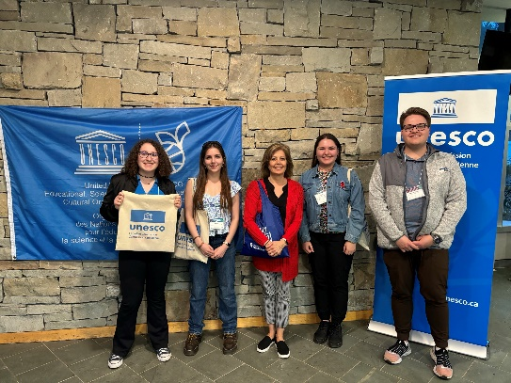
We are a UNESCO school!
Collège Pierre-Elliott-Trudeau has been a proud UNESCO school since 2005.
We are comprised of 11,700 educational institutions in 182 countries that support the UNESCO Associated Schools Project Network (ASPnew).
As a member of ASPnew, we are committed to supporting UNESCO’s mission and to incorporating its global goals into teaching, learning and action.
Four pillars to UNESCO are:
Learning to know – develop ideas to adapt, create new designs for change and understand how to leverage change.
Learning to do – plan an action, organize tasks and put a plan into action.
Learning to be – appreciate the natural world, contribute to its well-being and protect its inhabitants.
Learning to live together – engage in dialogue, respect others and resolve differences peacefully.

Slide 4
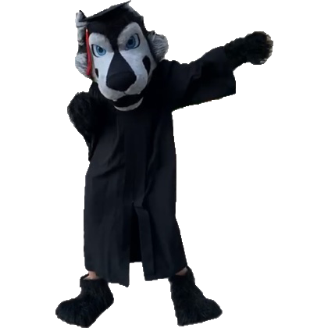
CPET is a French Immersion milieu centre
All courses, other than English, Music and AP courses are taught in French.

Slide 5
Grade 9 programming
Compulsory courses
Français 10F
Vie-travail: exploration 15G (LifeWorks Exploration)
ELA 10F
Canada dans le monde contemporain 10F (Social Studies)
Science de la nature 10F (Science)
Mathématiques 10F (Math 10F)
Mathématiques en transition 10F (Transitional Math)
Éducation physique et santé 10F (Physical Education and Health)

Slide 6
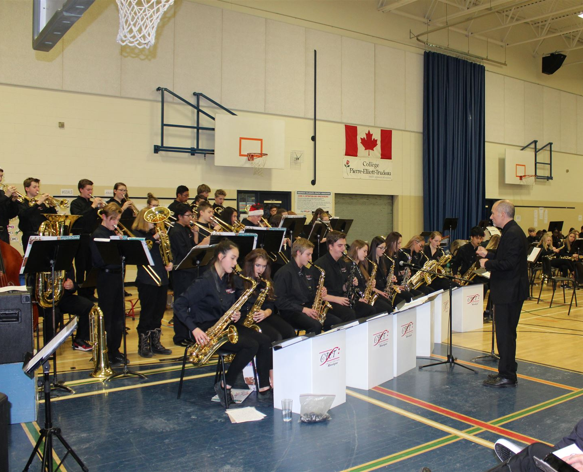
Grade 9 Option Courses
Students may choose 2 options
Innovations commerciales 10S (Business Innovations)
Arts dramatiques 10S (Drama)
Arts visuels 10S (Visual Arts)
Étude de la famille 10S (Family Studies)
Espagnol 10F (Spanish)
Application des technologies de l’information et communication 1 & 2 (Applying information and communication technology)
Music classes may occur in the morning (7:45am) or at lunch time
Choir 10S
Concert Band 10S
Jazz Band 10S

Slide 7
Other pathways offered at CPET
sTeam Program
Beginning in Grade 10
For students who want an interdisciplinary and project-based approach to learning.
Français, Science de la nature, art visuel → will be taken a full morning in one semester.
Advanced Placement
Offered for Grade 12 students. Language of instruction is English for AP courses.
Calculus AB 42S
Literature and Composition 42S
Chemistry 42S

Slide 8
Optional Intensive programs via RETSD starts in Grade 11
Kildonan East Collegiate
Automotive Technology
Baking and Pastry Arts
Culinary Arts
Collision Repair and Refinishing Technology
Electrical Trades Technology
Graphic Design
Hairstyling**
Interactive Digital Media
Photography
Refrigeration and Air Conditioning (HVAC)
Murdoch MacKay Collegiate
Carpentry
Fashion Technology
**Begins in Grade 10.

Slide 9
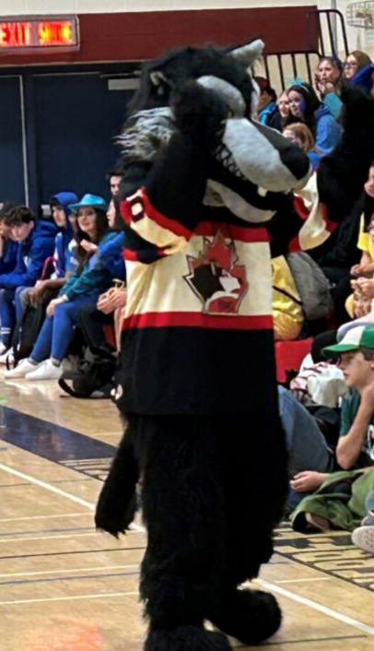
Grade 9 Program Organization
Grade 9 students are working in the high school credit system where a minimum of 30 credits are required to graduate. Most courses are worth 1 credit.
Students must earn a minimum of 15 credits in courses with French as the language for programming to qualify for the provincial French Immersion Diploma.
All Grade 9 students will be assigned to a Teacher Advisor (TA), who will meet monthly to share information pertaining to report cards, conferences, registration and delivering special school wide lessons throughout the school year.
All Grade 9 students will be assigned a Student Services personnel that will follow them until Grade 12 to ensure they meet the requirements for graduation. Student services personnel are there to support students with academic, social, and emotional well-being.

Slide 10
CPET Support Personnel
Support Personnel | Staff Member
Grade Level Counsellor | Mme Hocken-Attwell, Mme Yunyk, Mme Zerbin, Mme Pfeifer
Grade Level Resource Teacher | Mme Hocken-Attwell, Mme Yunyk, Mme Zerbin, Mme Pfeifer
Security Monitor | Mr Momar Thiongane
AFM Counsellor | Ms Candy Burke
School Resource Officer | Mr Orlando Buduhan

Slide 11
Grade 9 Program Organization
The school year is split into 2 semesters where courses run for one semester, except for a few courses that run all year for programming reasons (Français, Mathematics, Music)
Each class is approximately 65 minutes in duration.
Grade 9 students are fully scheduled throughout the day.
Grade 9 students will have full access to all clubs and extra-curricular activities.
Canteen is available to all students between 11:00am-1:00pm for purchase of food.
Microwaves are available throughout the day in our cafeteria.

Slide 12
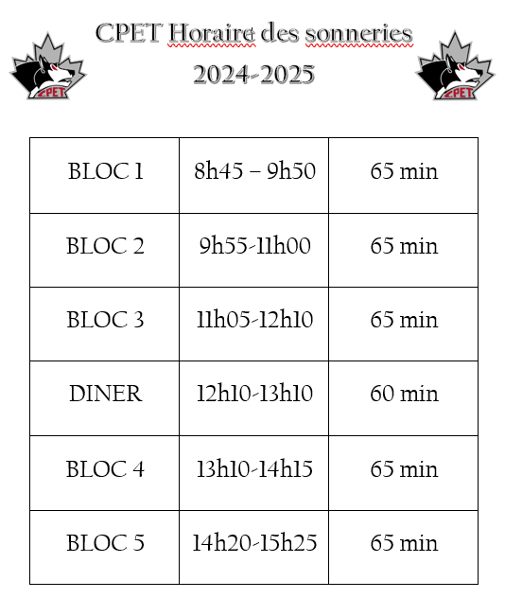
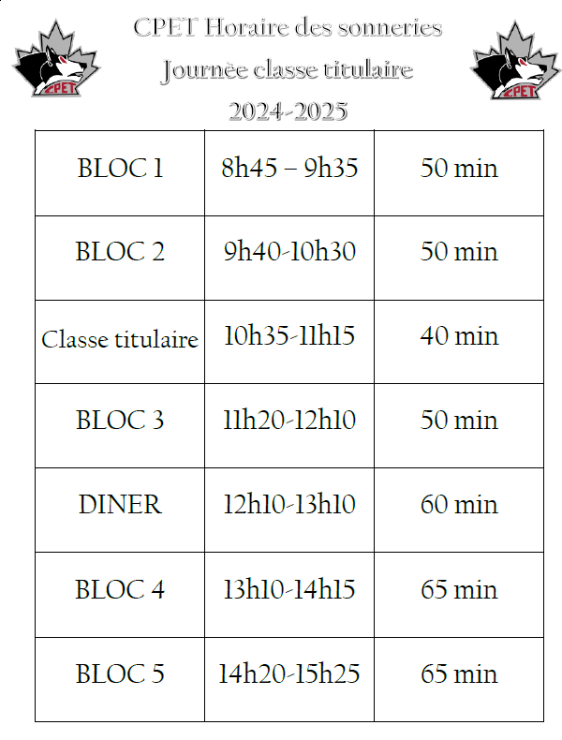
Daily Schedules

Slide 13
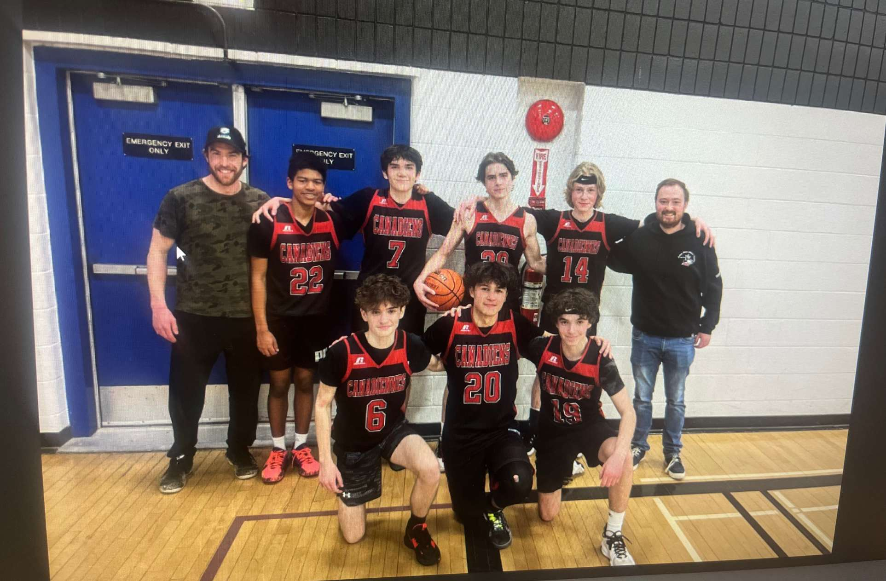
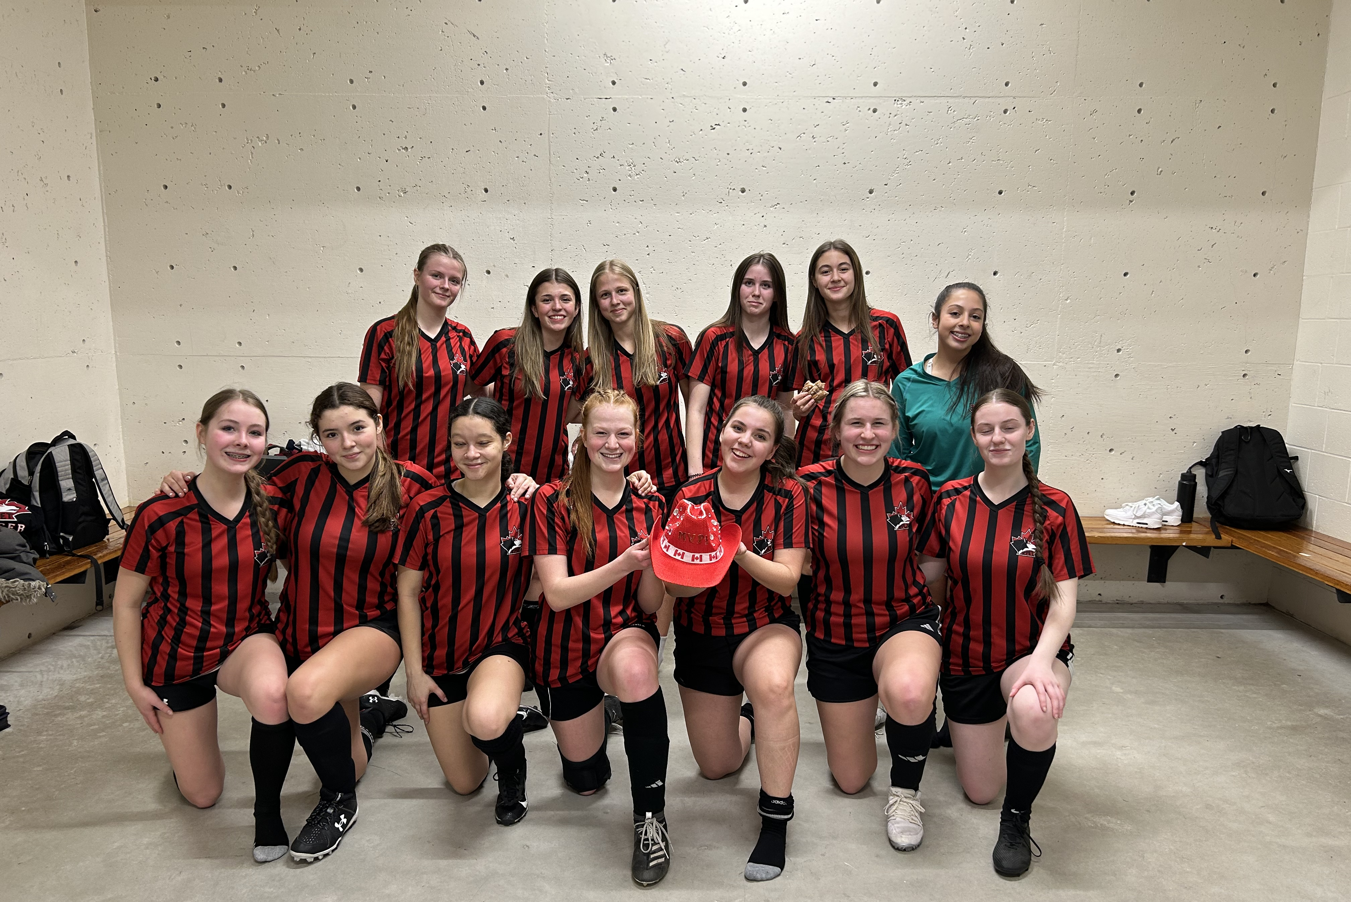
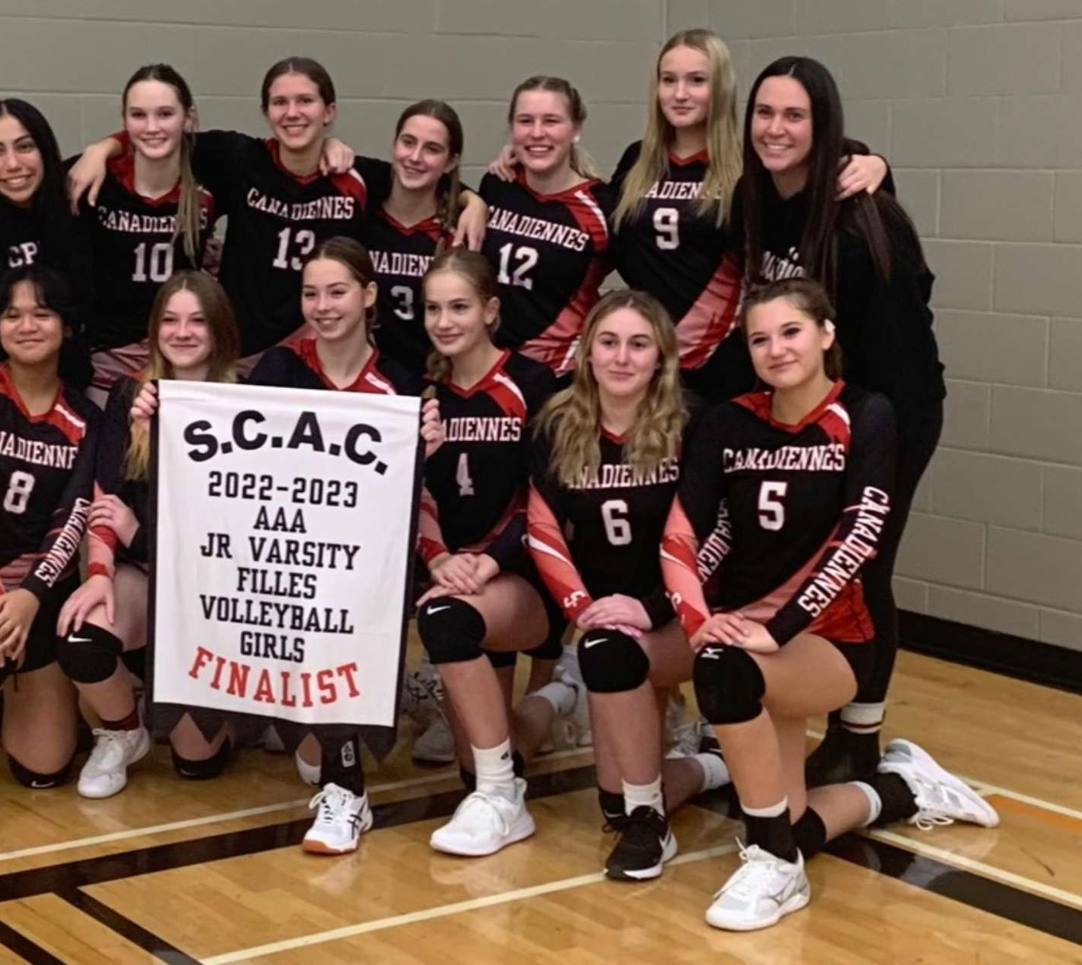
Athletics
Volleyball
Soccer
Basketball
Hockey
Badminton
Curling
Ringette
Track and Field
Dragonboat
Fastpitch

Slide 14
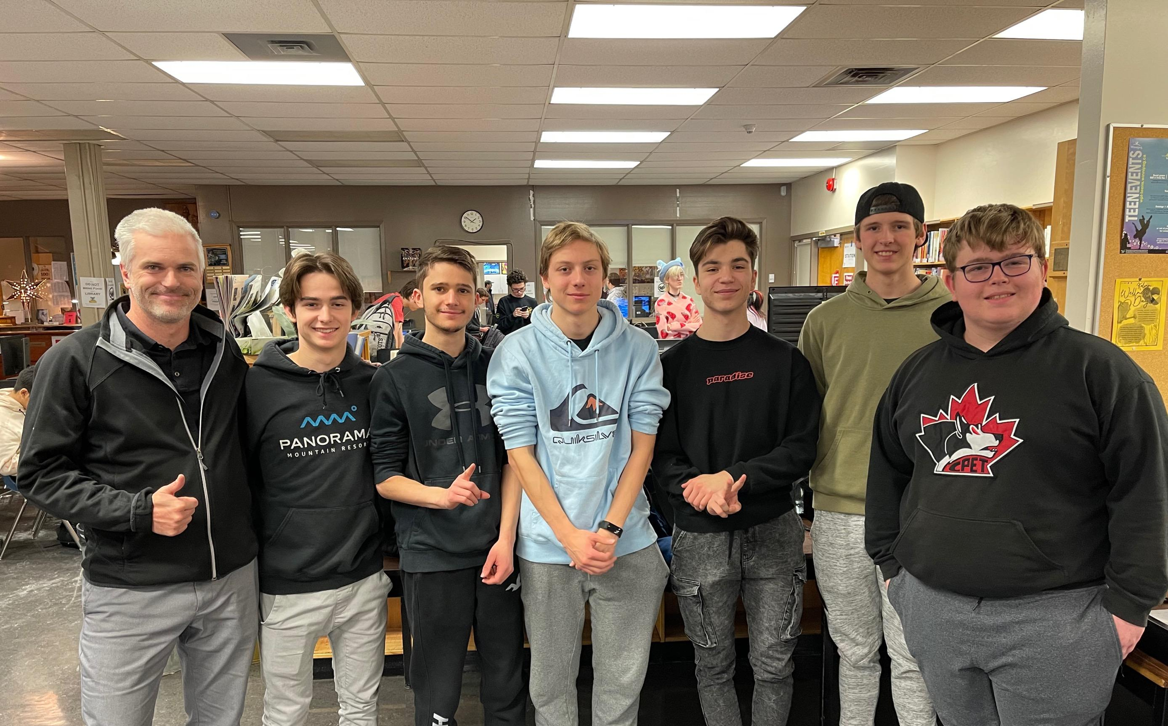
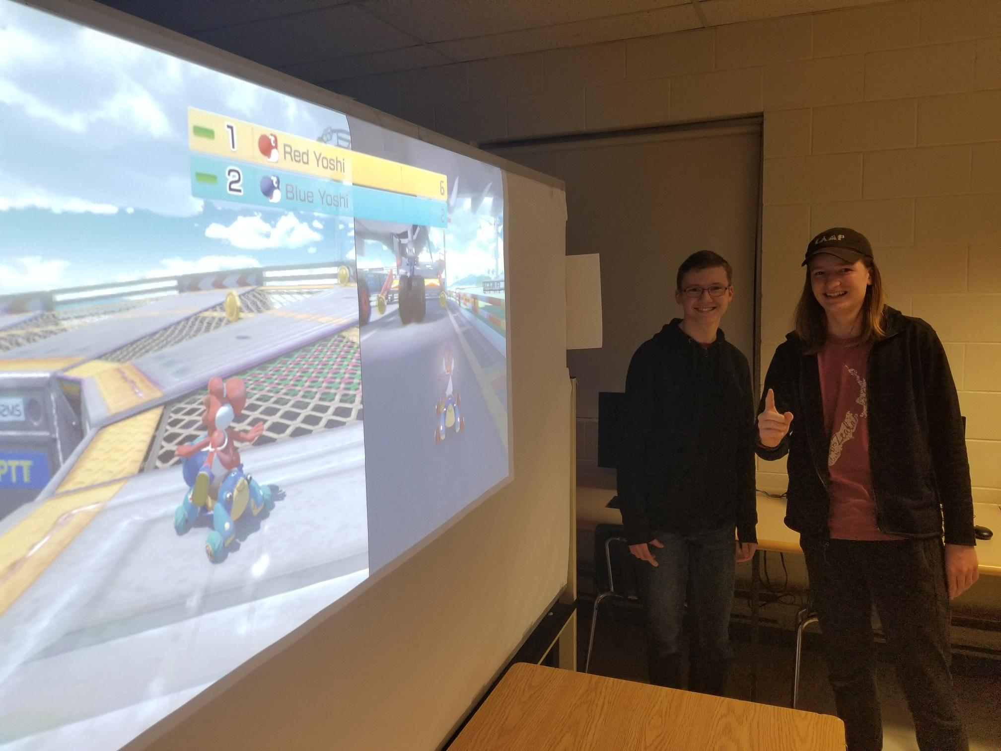
Clubs
E-sport
Karaoke Club
Student Council
GSA
UNESCO
Yearbook
Ethics Bowl
Indigenous Club
Creative writing
Arts Club
Sources of Strength
Games
Improv

Slide 15
Registration Information
Registration packages have been distributed to École Regent Park and École Dugald students.
Course manual is located on the CPET website, under Documents and Forms → Registration.
Registrations can be submitted to their current school by March 10th.
We do not require a copy of the recent report card.
For out-of-division students, please include:
Out-of-division application
Copy of 2 pieces of ID that has your current address.

Slide 16
Thank you!
Merci!

