Slide 1

Birds Hill School’s
POLAR BEAR CLUB
2023-24
What is polar bear recess and why does it matter?
How do social norms determine our response to cold weather?
How can we shift social norms in a healthier direction?

Slide 2
WHAT IS IT?
Voluntary club where kids can go outside for recess rather than stay indoors (-27 generally down to -40C).
Students can return indoors at anytime.
Parental consent required for participation.
the percentage drops to 28% for a “5-to-15-minute” commute.

Slide 3
WHY?
Children’s inactivity is at crisis levels, and we are seeing the impact of worsening physical and mental health in kids.
the percentage drops to 28% for a “5-to-15-minute” commute.

Slide 4
Public Health Agency of Canada:
While 42% of kids with a 5-minute commute walk to school, the percentage drops to 28% for a “5-to-15-minute” commute.
the percentage drops to 28% for a “5-to-15-minute” commute.
https://www.canada.ca/en/public-health/services/publications/healthy-living/lets-get-moving.html

Slide 5
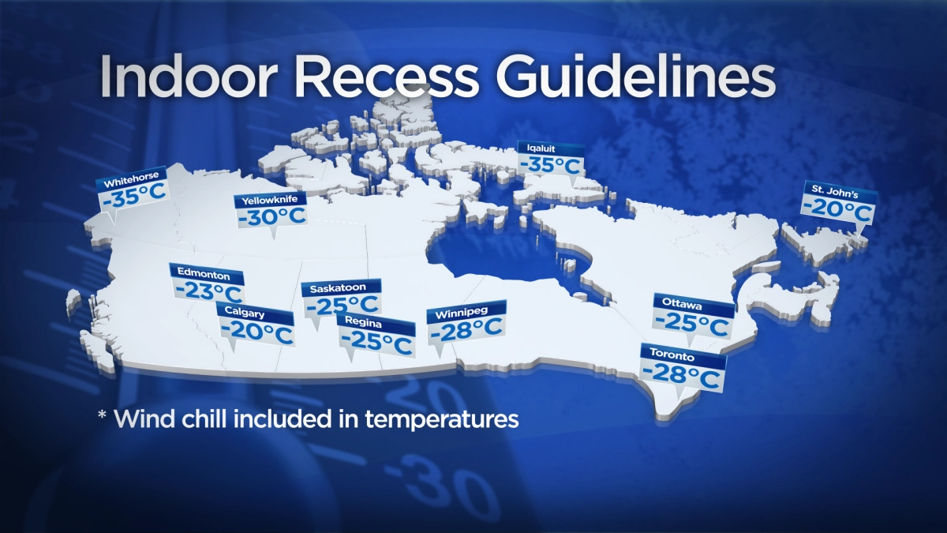
https://globalnews.ca/news/5027337/indoor-recess-canada-winter/

Slide 6
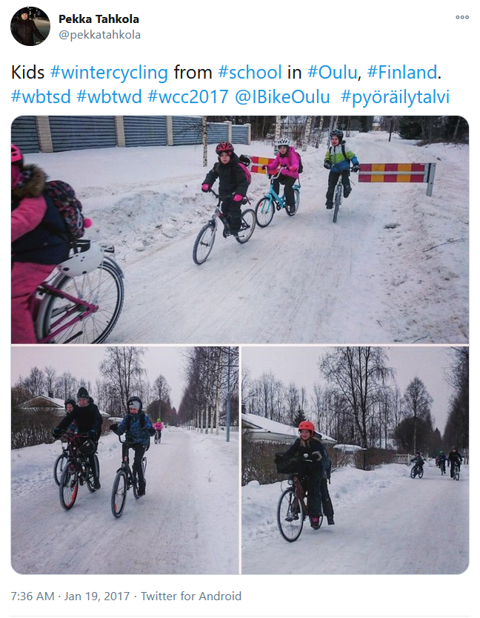
In some places, the culture never changed...
https://twitter.com/pekkatahkola/status/822075138892038144

Slide 7
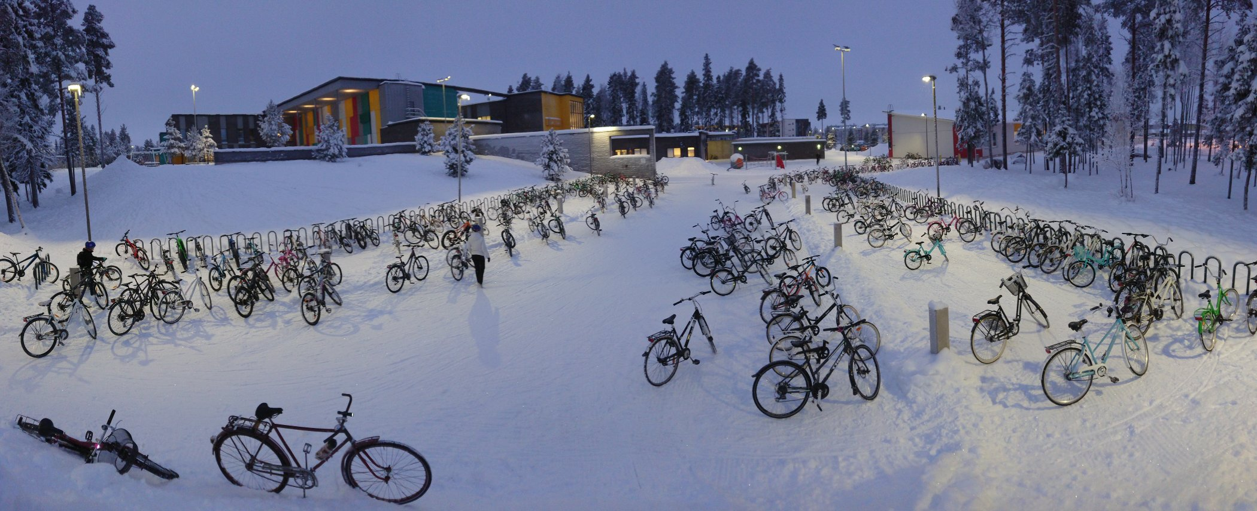
“It’s normal; always been like that.
I cycled and kicksledded to school when I was a kid, too...And it’s the same thing even in minus 30 C.”
-Pekka Takhola, Cycling Coordinator for Oulu, Finland
----1000 of 1200 kids at this school cycle daily
https://twitter.com/pekkatahkola/status/1093297261604265985

Slide 8
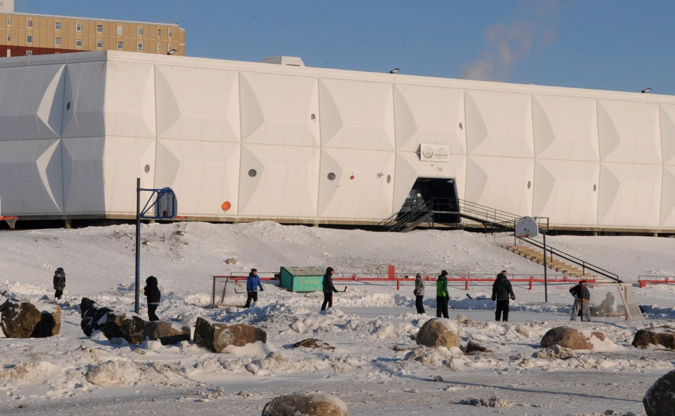
“You’ll find even on blizzard days, if the temperature reaches -50 C with the wind chill — they’re outside playing,”
-Doug Workman, Iqaluit District Education Authority
https://globalnews.ca/news/5027337/indoor-recess-canada-winter/

Slide 9
The Council of Chief Medical Officers of Health Endorses the 2015 Position Statement on Active Outdoor Play:
“Access to active play in nature and outdoors-with its risks-is essential for healthy child development. We recommend increasing children's opportunities for self-directed play outdoors in all settings-at home, at school, in child care, the community and nature.”
Suggestions for School Divisions:
Examine existing policies and by-laws and reconsider those that pose a barrier to active outdoor play.
Encourage and enable children to travel to and from school using active modes.
the percentage drops to 28% for a “5-to-15-minute” commute.
http://www.phn-rsp.ca/aop-position-jae/index-eng.php

Slide 10
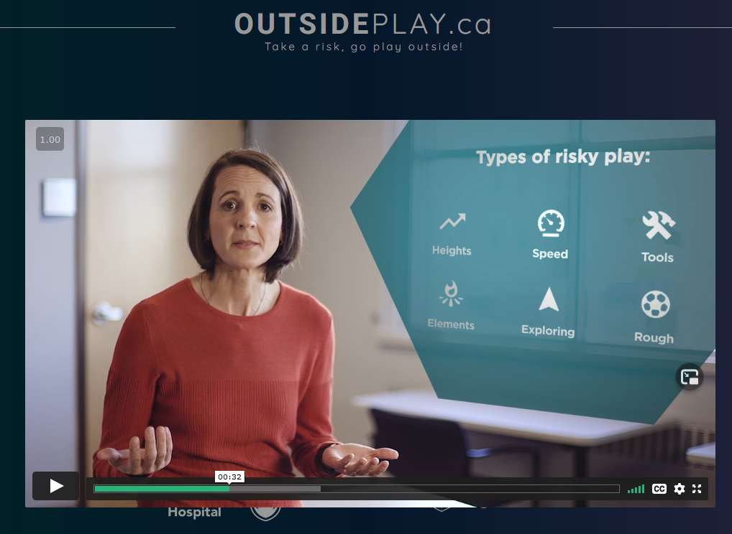
https://outsideplay.ca/

Slide 11
TO RECAP:
Health experts are calling for policy change to enable outdoor play
Our rates of walking to school in Canada, even within feasible distances, is far too low, with 72% of kids within a 15-minute walk being driven.
Perceptions of “too cold” to play outside/walk to school are subjective, varying around the world and even within Canada.
Social norms are malleable and are capable of changing rapidly (Hello, COVID-19!)
A Polar Bear Recess/Club can help to reverse the drop in children’s physical activity and mental resilience.

