Slide 1



Universities,
RRC Polytechnic
&
Scholarships
Congratulations - 2025-2026 CPET graduates

Slide 2
3 essential goals
Dates
  Post-secondary school presentations
  Lapse – applications
2. Scholarships
- 2 types
- Details
3. Scanning/searching – providing information
Come see me or send me a message – questions

Slide 3

You need - 5 - 40S courses – university (min)
Ed. Phys 40F
Math 40S
English 40S
Français 40S
Academic 40S
Academic 40S
Music + Visual Arts – counts as an academic course
Program dependent

Slide 4
Types of Awards and Scholarships
Internal scholarships – mix of grades, clubs, school and community participation – decided by a committee of teachers and staff
Entrance Awards and Scholarships – usually require a minimum average of +85%
When you apply to university

Slide 5
CPET - Internal scholarshipsto be discussed in February 2026
Please listen to the announcements and check in – Graduates at TEAMS
Selection of the School Scholarship Committee
There will be a deadline – be careful.
announced at graduation
Available only for CPET students (about 25 -30 available)

Slide 6
External Prizes and Scholarships: (outside the school) – all year round
CPET has no control - who receives these awards
Some scholarship opportunities are sent to high schools
Go to les finissants Team and click on the Awards and Scholarships link to see the opportunities
Listen to announcements every day
Come and see the scholarship boards at the counselling offices
All scholarships will be published – 26 Graduates at TEAMS

Slide 7
How to improve my chances of winning an internal, external or prize
classes, leadership, community
Known and recognized
Finissants à TEAMS
Make a request – ask and you may receive
good grades, attitudes, behaviour

Slide 8
Important Dates for Presentations –
12:10 p.m. – Day 1 – all in room 202
University of Saint-Boniface – Monday, October 20
University of Manitoba – Wednesday, October 22
University of Winnipeg – Tuesday, October 28
Red River Polytechnic College – Monday, November 3 CAB

Slide 9


Candidats aux études secondaires au Canada - Université de Saint-Boniface (ustboniface.ca)
It gives you an overview of the programs offered
Several programs!!
Education (post-graduation)
Science
Science Nurse
Multi-media
And so forth
  October 20 at NOON – room 202

Slide 10

Entrance Scholarship – if you apply before March 1, 2026
Average from 80% to 84.9%: $1000
Average of 85% to 89.9%: $1750
Average from 90% to 94.9%: $2500
Average of 95% and above: $3250

Slide 11


Other scholarships
$3000 - Immersion Students (ACUFC) – declare your first language is English
BEF – Minority Language Scholarship
Automatic + Request Required

Slide 12


Overview of programs, etc.

Slide 13

Entrance Scholarships 2026
March 1
3 courses - minimum of 65% on average from Grade 12 courses
English
Math (Essentials accepted)
Another one
Faculty dependent(Math and Science)
Education/Science/Pre-Med
Minimum of 12 credit hours for the fall (4 courses)
You cannot receive a scholarship worth more than $5,000 from any other source
95%+ | $2,250
90-94.9% | $1, 750
85-89.9% | $1, 100

Slide 14
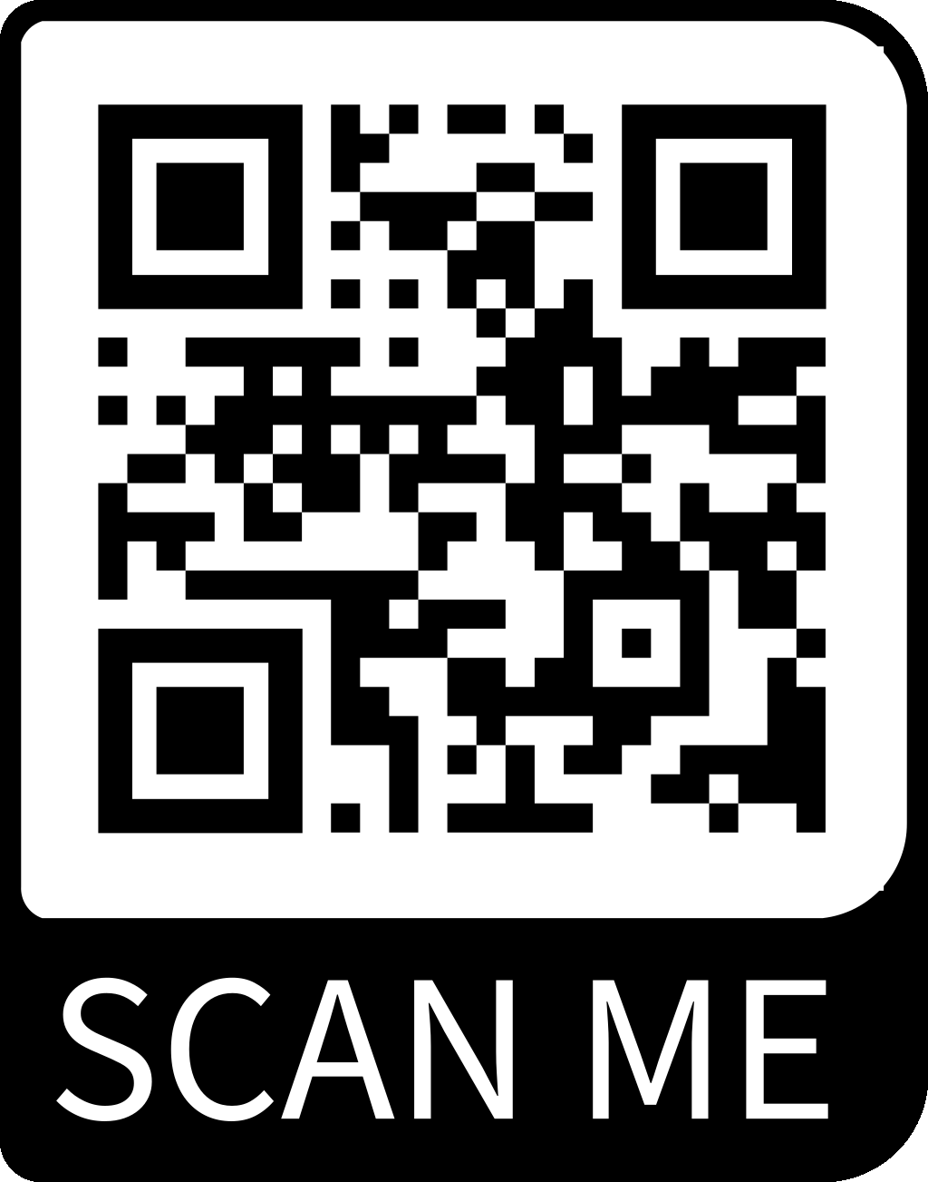
University of Winnipeg application-based scholarships (not automatic – application required)
DUE DATE - February 1, 2026.
Ranges from $100 to $48,000.
The application must be completed by Feb. 1, 2026.
You must have an account – already registered for next year

Slide 15

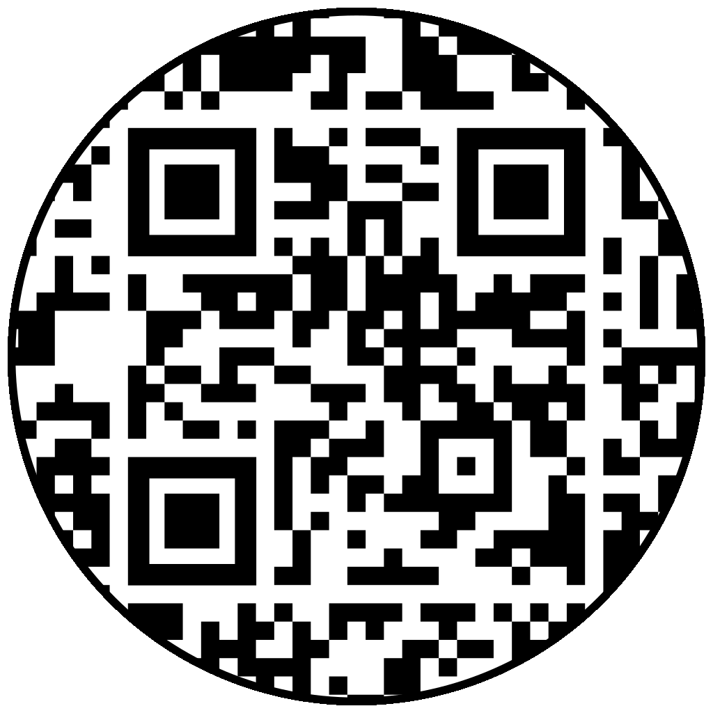
Go BISONS!
First Year Planning Guide

Slide 16
Entrance Scholarships - Automatic
must apply
BEFORE March 1st
Transcripts are automatically sent by our division
Semester 1 grades
Semester 2 Midterm - No adjustment for final grades
You must self-declare (guess approximately) your grades.
Receive a scholarship you need - Minimum of 24 hours of classes for the entire year at UM
95% + | $3,000
90% - 94.9% | $2,000
85% - 89.9% | $1,000

Slide 17

GPA
U1, Arts – 70% min
Other faculties – see website for details
Science/Health Sciences
  Entrance Scholarships
  Minimum average of 85% on the top five courses on a pre-approved list

Slide 18
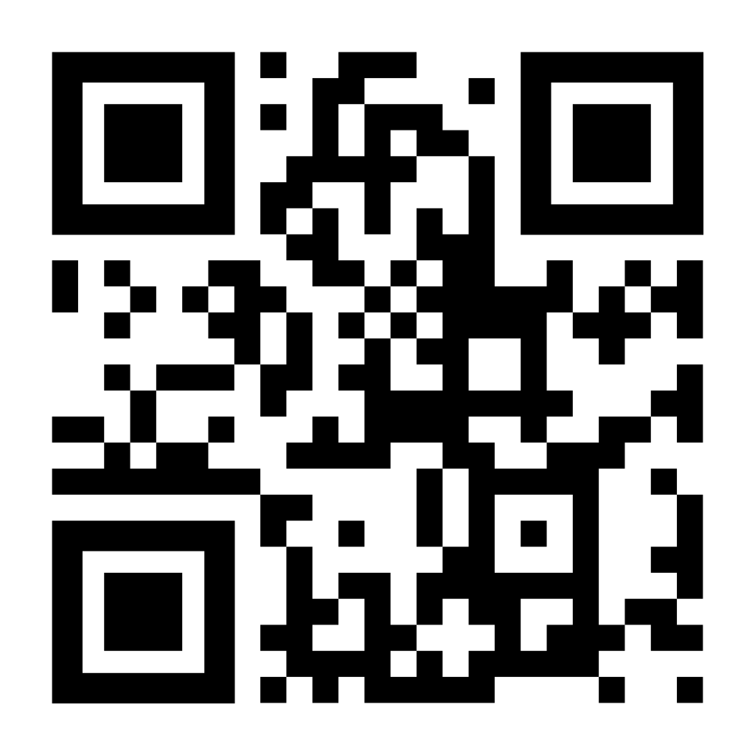
UM Academic 40S Pre-Approved Courses - Scholarships

Slide 19

Based on financial requests
http://umanitoba.ca/financial-aid-and-awards
For information and a scholarship application form
https://ui-webapps.ad.umanitoba.ca/searchableAwards/
For Indigenous students go to:
http://umanitoba.ca/financial-aid-and-awards/indigenous
This Photo by Unknown author is licensed under CC BY-NC.

Slide 20
Leaders of Tomorrow Scholarships - LOT/ ILOT
BMO Financial Group Leader of Tomorrow Scholarships | University of Manitoba (umanitoba.ca)
Due date – December 1 – registration required
90% in 30S courses
Leadership and volunteerism in the community
Involved in school sports and clubs

Slide 21

If you apply by December 1st – automatically entered for 10 tuition prizes paid $5000**
March 1 to be considered for entrance scholarships
School of Art - and portfolio – due date – 1 MARCH
January 15 – Music – come and see me

Slide 22


So many excellent programs!!
  Full-time and part-time
  Graduates get jobs - recognized
  Co-op Programs - $$

Slide 23

  Skilled Trades – TRADES and TECHNOLOGY
  Carpentry, Welding, Mechanic
  Nursing
  Technology
  Cybersecurity
  Education
  Hospitality–
  Culinary Arts
  Tourism
  Creative Communications- UW – journalism, writing, broadcasting, etc.

Slide 24
Registration dates and required courses
Extremely different and detailed – search the website and come see me.☺

Slide 25

Awards and Scholarships

Slide 26
For Indigenous/Métis Students - MIYAA
MB Youth Indigenous Awards – Due date October 13
Manitoba Indigenous Youth Achievement Awards – Celebrating Outstanding Indigenous Youth
Academic
Entrepreneur
Athletics
Arts
Culture
Community Involvement
**Two Technology Awards for Women

Slide 27

REGISTER BEFORE Dec 1 (UM Scholarships)
March 1 (universities)
Transcript will be sent by the division automatically if you register by March 1 – UM and UW

Slide 28

Are you ready to apply?
You must have with you when you apply online:
1. MET Number (on your report card/parent portal)
2. Credit card
$100 - $110
***********
Transcript - only for Red River Polytechnic College or MITT, Booth. etc. or after March 1
– an electronic or paper copy of the transcript must be sent
- and you must also send a final copy after June 30
***or if you apply after March 1 at the university – and June 30

Slide 29
Create an account
Use your personal email
It's going to take you at least 6 – 10+ minutes
Predict your grades
You will receive a conditional acceptance – you have to wait until June 30th
Notes:
Different pour chaque faculté

Slide 30
The small details to consider
Due dates
References - get them well in advance
Consider the Scholarship Criteria
Well-written and well-written letters of request

Slide 31
Other Sites - search for more external scholarships
https://yconic.com/
http://www.universitystudy.ca/indigenous-students/
http://indspire.ca/
Prizes and Awards
Scholarships, grants and bursaries for Canadian students - University Study
Notes:
All hyperlinks work

Slide 32
Other Places to Look for External Scholarships
Extracurricular activities
Sports Organizations
Club Affiliations
Veterans Group – Veterans
Place of work
or parents/grand-parents work
Community Groups
Religious Institutions

Slide 33

External Scholarships and Awards
Schulich – must be chosen by the school
Leaders - Schulich Leaders – STEM
Loran Scholar – go out of Winnipeg
Homepage - Loran Scholars
Nellie McClung Foundation – women – STEM
Nellie McClung Trailblazer Scholarship | The Nellie McClung Foundation

Slide 34
External Scholarships and Awards
MB School Board Trustee
Awards - Manitoba School Boards Association (mbschoolboards.ca)
Beaumont – Financial Requirement/Application Letter
beaumont-education-fund-guidelines-info-student-application-2425.0111e227543.pdf

Slide 35
Scholarships – financial need
Most universities open applications for scholarships in the spring
The deadline to apply is September 2026
Check university and college websites for specific deadlines and instructions
Do the research - ask and you can receive

Slide 36

Financial Aid + Scholarships, Awards
MB Student Aid $$$
0% interest to be paid after.

Slide 37
Autres Écoles Post-Secondaires à Manitoba
OTHER POST-SECONDARY OPTIONS
Booth – SOCIAL WORKERHome - Booth University College (boothuc.ca)
CMU Canadian Mennonite University -
Canadian Mennonite University | CMU | Christian University Education in Winnipeg, Manitoba
MITT Manitoba Institute of Trades and Technology
Manitoba Institute of Trades and Technology (mitt.ca)

Slide 38
OTHER POST-SECONDARY OPTIONS
Brandon U – PSYCH NURSE + MUSIC
Brandon University
Providence – PILOT
Home Page - Providence University College and Theological Seminary
Robertson Career College
Robertson College: The School of New Work

Slide 39

Indecisive?
My Blueprint
Schedule a meeting

Slide 40
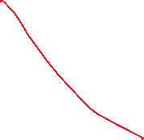

Defer - Postpone your award
For one year – only
Not Education for UW

Slide 41

University/College –Open House
UM
Future Student Night –Tuesday, October 285:30 – 8:00 pm
Open House | Explore UM | University of Manitoba
Open House
Thursday, February 19, 2026
UW
Future Student Night – November 25, 6:00 – 8:30 pm
OPEN HOUSE – February 21, 2024
Home | Future Student Night | The University of Winnipeg
USB
Not determined
Red River Collège Polytechnic
RRC Polytech: Future Student Events

Slide 42
Student Committee for Graduation
First meeting - September 29 – counselling area – at lunch
Grad wear
Winter Ball
liaise with the Parent Committee
Other?

Slide 43

Questions??

