Slide 1
Transcona Collegiate
Scholarship Information and Post -Secondary Admission Requirements

Slide 2
Purpose
-Provide information regarding admission to post-secondary institutions and scholarships

Slide 3
Agenda
1. Review of University/College Entrance
Requirements
2. Entrance Scholarships
3. Overview of Scholarship Booklet

Slide 4
Options
for
University
Entrance

Slide 5
Must meet high school graduation requirements and have 5 full credits at the S, G or U level - PE does not count

Slide 6
University of Manitoba- U1 options: Regular – 5 courses needed; minimum of 70% average in 4 courses including Eng, Math and two other S courses with a minimum grade of 60% in any course (could only use 1 of drama, dance, graphics, electronics, woods) Limited admission/ same as above except a minimum average of 65% with no less than 55% in each course Specific faculties have additional requirements- see website .http://umanitoba.ca/admissions

Slide 7
University of Winnipeg-
5 Grade 12 S or G courses required to apply
Present a minimum of one core credit in English ( Comprehensive, Literary or Transactional Focus), one credit of Mathematics ( Pre- Cal, Applied or Essentials) and one other 40S level course with a minimum 65% average overall.
Admissions Requirements | Future Student | The University of Winnipeg (uwinnipeg.ca)

Slide 8
Admission to Colleges
Most colleges require a regular high school diploma which means 30 credits, including English 40S, Math 40S, PE 40F and two other 40 level courses.
Specific math or science requirements may apply depending on the program.
Check with the college for specific details.
Red River, Assiniboine, Booth, Robertson, Herzing, MITT, Wellington, etc.

Slide 9
Newcomer /International Students
Please communicate directly with an advisor at the post- secondary institution of your choice.
Residency status, visa requirements, language proficiency, etc. are individually determined factors in your application

Slide 10
Entrance Scholarships at U of M
5 of the following grade 12 courses will be used to calculate your average for entrance scholarships:
*English (may use two English courses)
*Math - Pre Cal or Applied or AP Calculus
*Biology, Chemistry, Physics and Computer Science
*Family Studies or Foods and Nutrition
*Global Issues
*French or another language- must be a 40S credit (ex. Ukrainian/Spanish/Filipino) and not 41G (ex. Punjabi/Russian )
*Music (one only)
*Visual Art
*Current Topics in First Nations, Metis and Inuit Studies
Advanced placement courses can be used

Slide 11
Entrance Scholarships at U of W
Your average will be calculated based on your English, Math and one other 40S level course
English – any of the three types we offer
Math –Pre- Cal, Applied or Essentials
One other 40S course
( Electronics does not count as it is 40G, neither do PE/ Credit For Employment/Volunteer as they are pass/fail)

Slide 12
Entrance Scholarship Values
University of Winnipeg University of Manitoba
95% and over = $2250 95% and over = $3000
90%-94.9% = $1750 90%-94.9% = $2000
85%-89.9% = $1100 85%-89.9% = $1000
Offers are based on first semester final grades and second semester interim grades. Final transcripts are reviewed and offers may be adjusted , depending on the institution.
*** separate monetary awards are also offered for AP courses scoring 4 or 5 ( $150-$250.00 per course) at U of M

Slide 13
Indigenous Student Information
Admissions | Indigenous | University of Manitoba
Home | Indigenous Studies | The University of Winnipeg
RRC Polytech: Indigenous Education
Indigenous Students - MITT

Slide 14
How Do I Apply?
The best way to apply to any post – secondary institution is online.
For the U of M and U of W, once you have applied, you are automatically entitled to entrance scholarships provided you meet their minimum GPA of 85%.
Your application must be fully completed by the deadline of March 1st)

Slide 15
IMPORTANT:
In person presentations at TC in the MPR:
November 19th
University of Manitoba – 2:25 p.m.
November 20th
- Red River Polytech – 11:05 a.m.
- University of Winnipeg - 1:20 p.m.

Slide 16
Fall Future Student Events
U of M – Fall Open House October 28 – 5:30-8:30 p.m.
Open House | Explore UM | University of Manitoba (umanitoba.ca) U of M – New Buffalo Education Gathering (Indigenous students)
November 14 - 9:00 a.m.-3:00 p.m.
New Buffalo Education Gathering | Explore UM | University of Manitoba
U of W Future Student Night and Open House – November 25 - 6:00-8:30 p.m.
Home | Future Student Night | The University of Winnipeg (uwinnipeg.ca)

Slide 17
Start now …..
Check websites – many have online sessions that you can view when it is convenient
Gain as much information as you can in order to make a well- informed choice
Application fee is approximately $100.00 (RRC $122.00)

Slide 18
Other links to explore ……
https://umanitoba.ca/admissions/viewbook
http://umanitoba.ca/careerservices
https://www.uwinnipeg.ca/future-student/start-here.html
https://www.rrc.ca/future-students/

Slide 19
The Application Process
Adhere to deadlines (late applications are not accepted)
Provide references (ask early)
Essays (free of errors, easy to read)
Save applications
Accomplishments (make a list)
Match accomplishments with award criteria

Slide 20
T.C. Scholarship Booklet
Includes information on:
how averages are calculated
where to look for potential scholarships
specific scholarships for Transcona Collegiate grads
financial aid websites

Slide 21
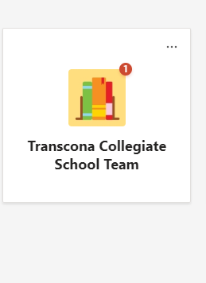
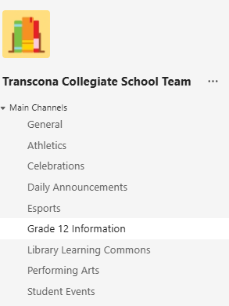

Slide 22
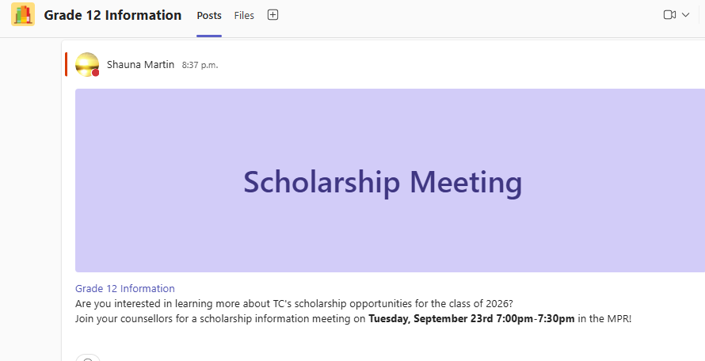

Slide 23
TC online scholarship application will be accessible by March 11, 2026.​
​
Deadline for this application will be Thursday, April 23, 2026.​
​
Other scholarships have separate deadlines.

Slide 24
What to do next?
1) Set a reminder in your phone to check the TEAMS – grade 12 info channel weekly and the Scholarship link on the TC homepage
2) Check out myblueprint.ca for help with career planning. Use your school log in to access this.
3) Explore post-secondary information – either in person or online

Slide 25
Remember:
Not everyone knows what they want to do “when they grow up” – that’s okay – you will figure it out as you explore options
(Ask your parents or other adults if they are still doing the same job that they thought they would be doing at age 17)
Apply for scholarships – sometimes there are few applicants. If you spend 5 hours on an application and are awarded $500.00 – you were paid $100/hour!!!!

Slide 26
Please reach out if we can help in any way!!
Ms. Janet Knutson – jknutson@retsd.mb.ca
Ms. Shauna Martin – smartin3@retsd.mb.ca
Mrs. Cheryl Young – cyoung@retsd.mb.ca
Message through TEAMS chat or send an email
Call the school at 204-958-6440

